Slide 1

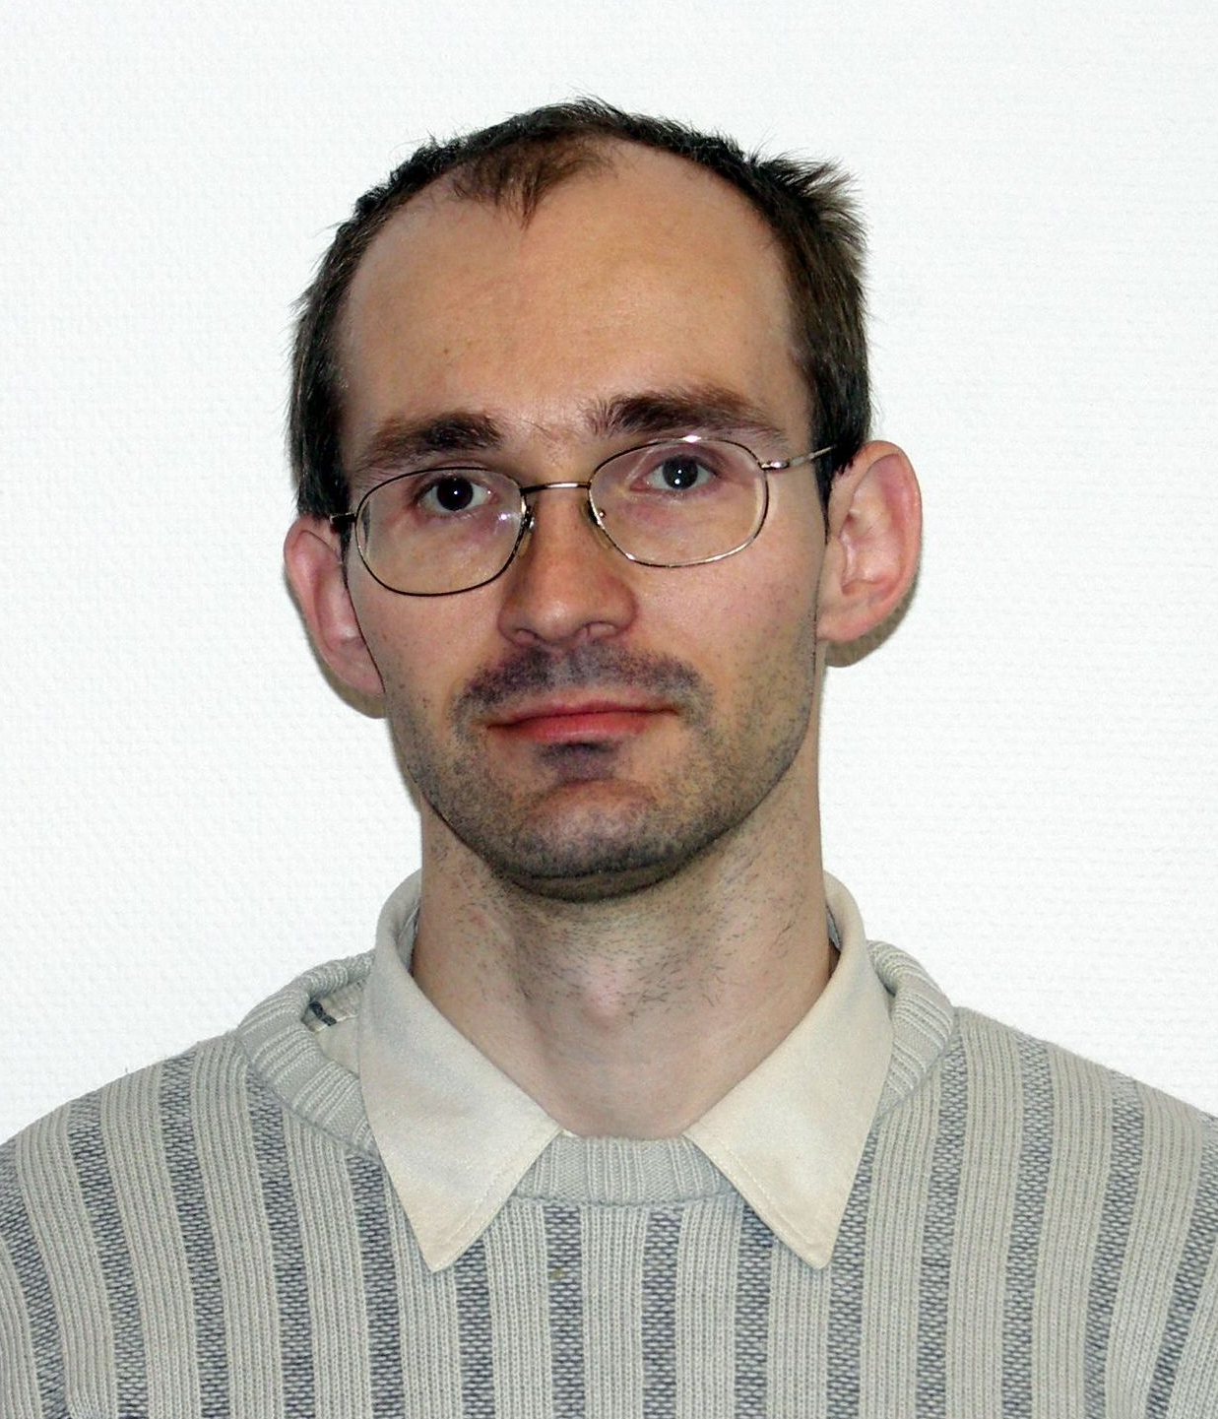
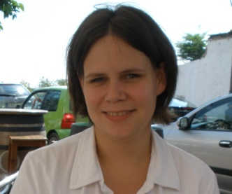
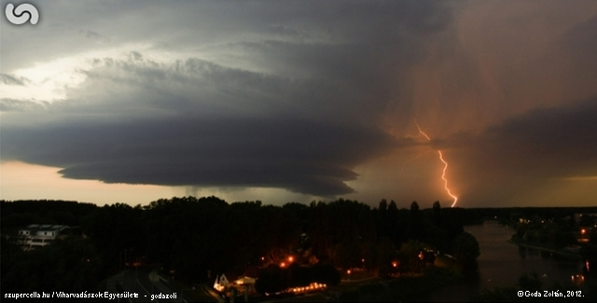
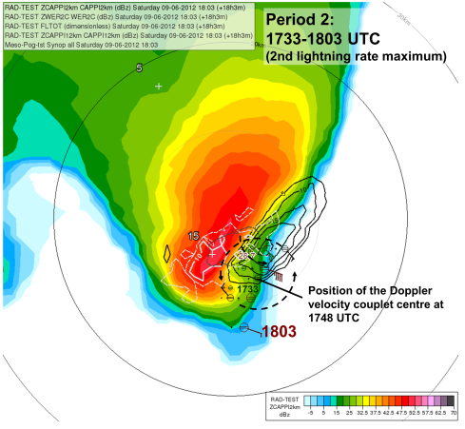
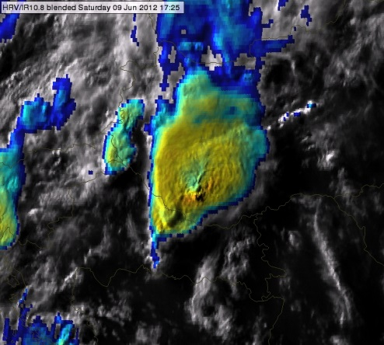
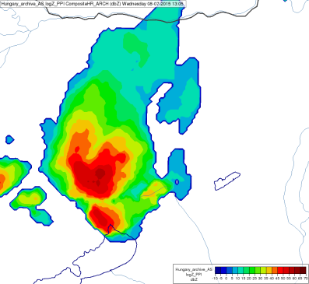
Case studies of various types of storms using
satellite, radar and lightning data
André Simon, Mária Putsay and Zsófia Kocsis
Hungarian Meteorological Service
EUMeTrain Convection Week, 23 May 2019, on-line presentation
A. Simon
Zs. Kocsis
Photo: Zoltán Goda

Slide 2
Outlines
Introduction
Five case studies
  Supercell, hailstorm (09 June 2012)
  Hybrid multicell-supercell storm, windstorm (08 July 2015)
  Tornadic storm (16 August 2010)
  Multicell storm and flashflood (31 July 2016)
  Single cell, short-lived local thunderstorm (23 July 2016)
Summary

Slide 3
Outlines
Introduction
Five case studies
  Supercell, hailstorm (09 June 2012)
  Hybrid multicell-supercell storm, windstorm (08 July 2015)
  Tornadic storm (16 August 2010)
  Multicell storm and flashflood (31 July 2016)
  Single cell, short-lived local thunderstorm (23 July 2016)
Summary

Slide 4
How much are the lightning characteristics related
to other severe storm features
on radar and satellite imagery?

Slide 5
Outlines
Introduction
Five case studies
  Supercell, hailstorm (09 June 2012)
  Hybrid multicell-supercell storm, windstorm (08 July 2015)
  Tornadic storm (16 August 2010)
  Multicell storm and flashflood (31 July 2016)
  Single cell, short-lived local thunderstorm (23 July 2016)
Summary

Slide 6
5 cases of different kinds of storms developed in the Carpathian Basin
    Synoptic situation
    Environment
      Radiosonde, NWP, GII, IASI
    Development of the storms
        Storm tracking → temporal courses of satellite, radar, lightning parameters + features and severe weather reports
      Spatial distribution of the lightning density within the storm structure (ECSS poster – Simon et al., 2017)
Satellite - METEOSAT SEVIRI RSS (5-minute data)
  Lightning – data of LINET network
Hungarian radar system - Three/four Doppler dual-polarization DWSR radars
  5-minute reflectivity data
  15-minute Doppler wind measurement
Severe weather reports from ESWDB or from surface measurements, no hail pad data
NWP, GII, IASI

Slide 7
Outlines
Introduction
Five case studies
  Supercell, hailstorm (09 June 2012)
  Hybrid multicell-supercell storm, windstorm (08 July 2015)
  Tornadic storm (16 August 2010)
  Multicell storm and flashflood (31 July 2016)
  Single cell, short-lived local thunderstorm (23 July 2016)
Summary

Slide 8
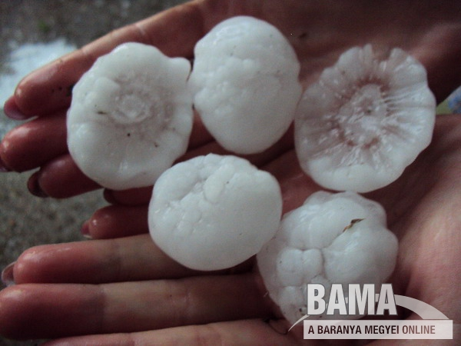
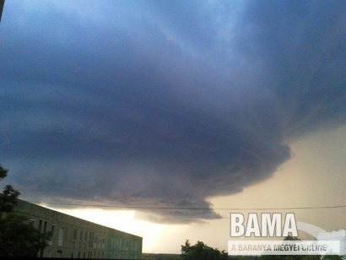
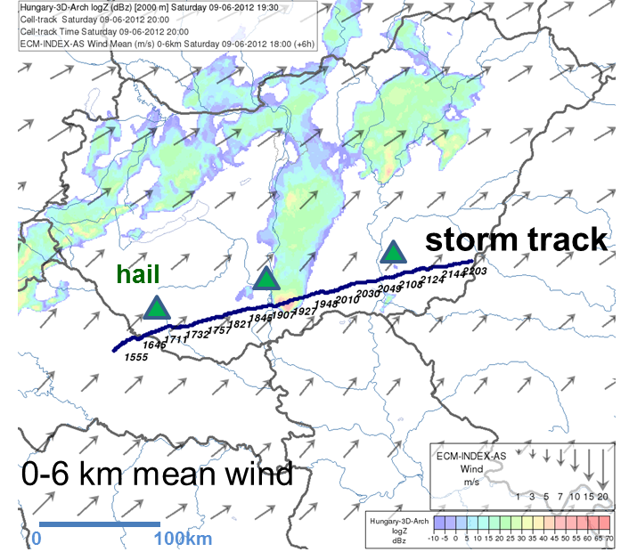
What happened?
The storm (classic or HP supercell) passed over southern Hungary (16-21 UTC), causing large hail (3-6 cm) at many places.
Synoptic situation
The studied convective system developed at a wavy front.
Photo: Zoltán Goda
View of the cell from East, at the city of Baja (~19:00 UTC)
Environment at the southern part of Hungary
Moist atmosphere, moderate instability,
strong 0-6 km wind shear
Storm track

Slide 9
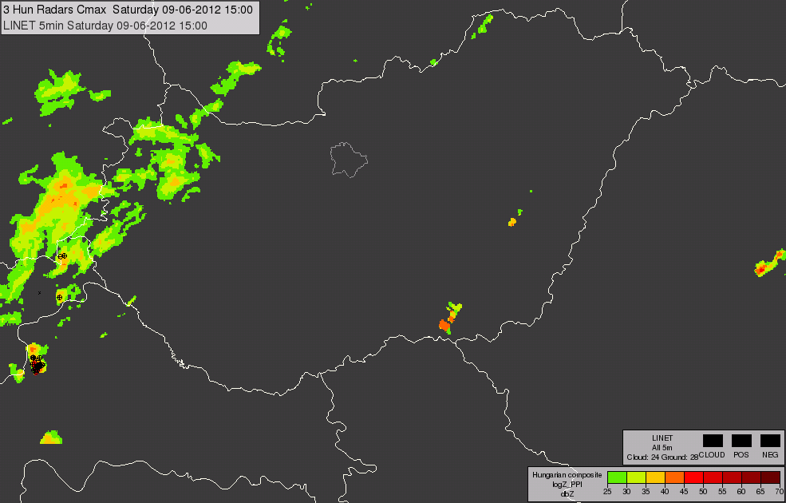
Convective system ~13-14 UTC - ~23:00 UTC It initiated over Croatia, propagated over Hungary
We studied the supercell, which initiated close to the Hungarian Croatian border until it interacted with a multicellular system at east of Hungary (15:50 - 21:50 UTC)
Animation created from Column maximum composite from 3 Hungarian radars overlaid with lightning strokes (09 June 2012, 15-23:55 UTC)

Slide 10
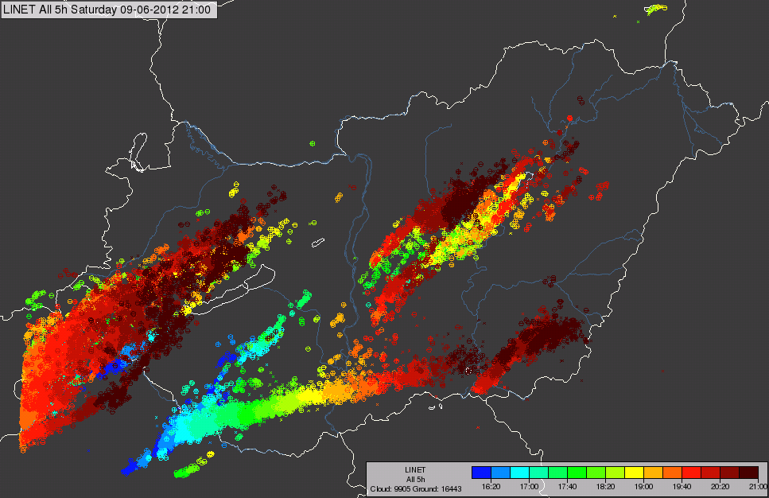
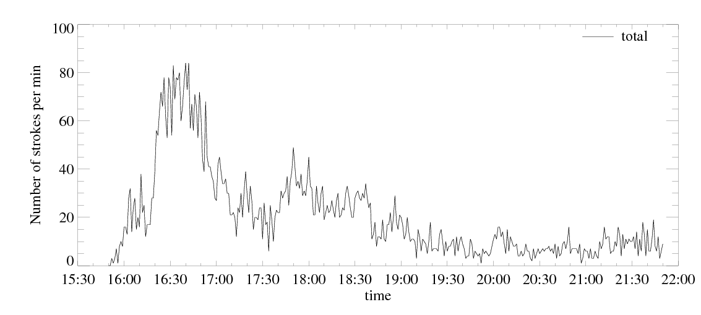
5-hour lightning
Storm development
Severe storm features
Lightning features indicating possible severity:
‘Lightning jump’ - sudden increase of the number of strokes
High stroke frequency (up to 80 strokes/minute)
      Right mover
Right-moving
Lightning strokes (total) belonging to the studied radar cell
Number of Total strokes / 1 minute
Lightning stroke rate

Slide 11
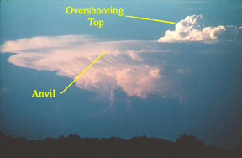
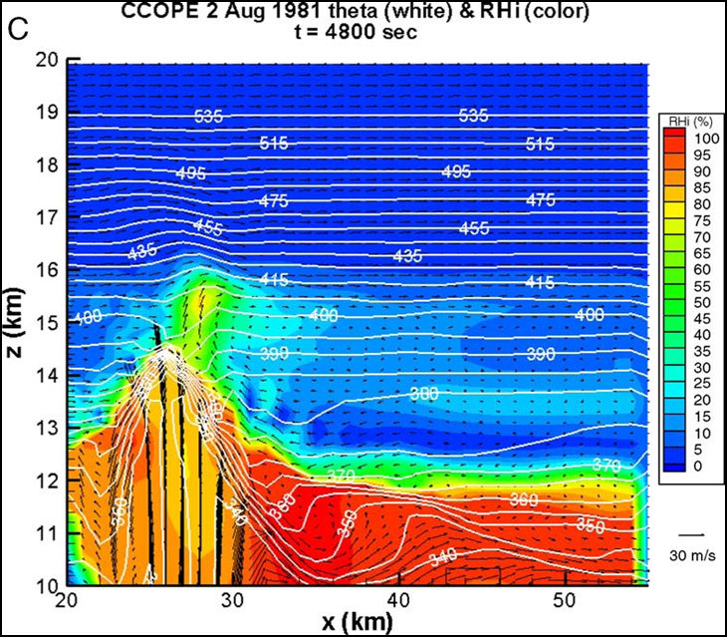
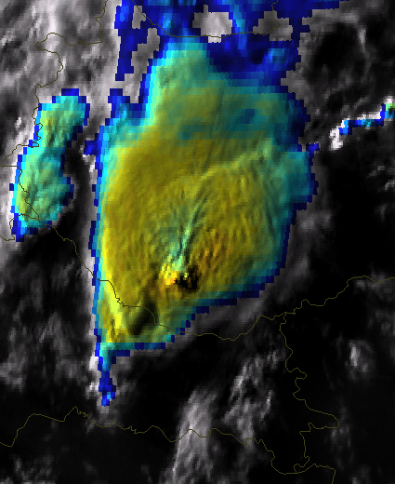
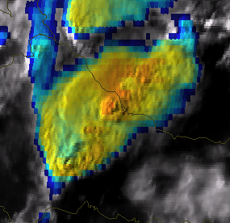
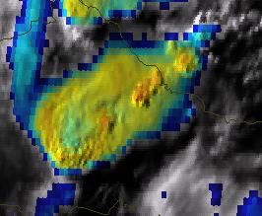
Satellite cloud top features indicating possible severity of the storm
  High cooling rate
    Right mover
    Extreme cold overshooting tops (OT) (down to -66.3 °C)
    Long lived overshooting top
    Long-lived Cold ring (more than 8 hours)
    High difference between the coldest BT10.8 of the ring and
                the warmest BT10.8 of the warm spot
    Over anvil ice-plume
    Small ice crystals on the cloud top
HRV/IR10.8 blended images 16:03,16:25, 17:33 UTC

Slide 12
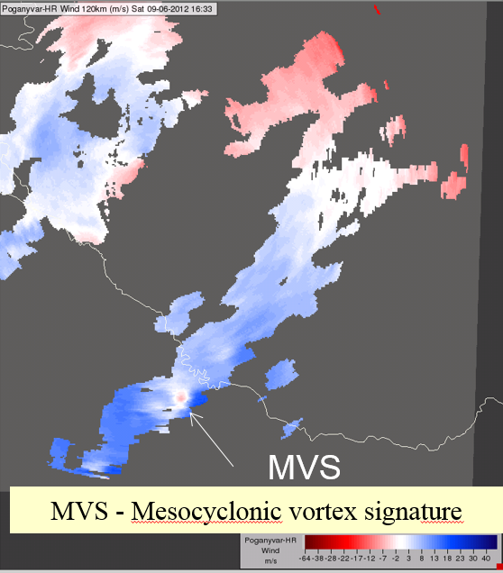
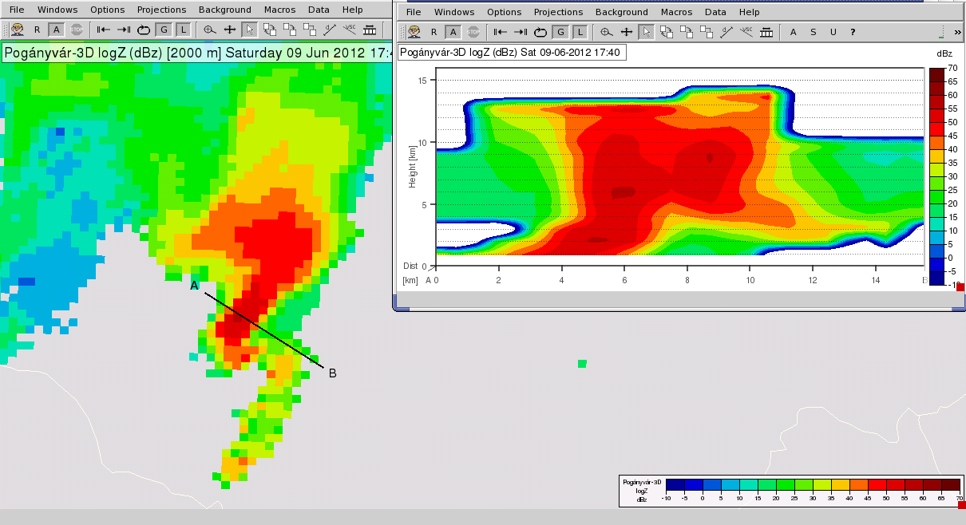
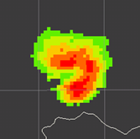
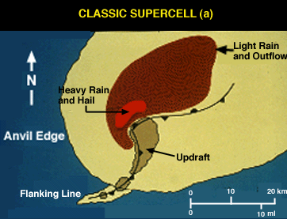

16:33 UTC
Radar features indicating possible severity of the storm
  Doppler wind feature - MVS – indicating rotation (next slide)
  Right mover
  Long-lived intense radar cell (more than 8 hours)
    High reflectivity values (up to 61.5 dBz)
    High Vertically Integrated Liquid (VIL) values (up to 76 kg/m²)
  Hook, bow and WER/BWER echoes
Which one is the hook echo?
RIJ – rear inflow jet
Persistent mesocyclone
… echo (2 km CAPPI) 17:40 UTC
RIJ
… echo
in 9 km CAPPI
20:15 UTC
WER+BWER echo (vertical cross section) 17:40 UTC
Flanking line

Slide 13
16:33 UTC
Radar features indicating possible severity of the storm
  Doppler wind feature - MVS – indicating rotation (next slide)
  Right mover
  Long-lived intense radar cell (more than 8 hours)
    High reflectivity values (up to 61.5 dBz)
    High Vertically Integrated Liquid (VIL) values (up to 76 kg/m²)
  Hook, bow and WER/BWER echoes
RIJ – rear inflow jet
Persistent mesocyclone
Hook echo (2 km CAPPI) 17:40 UTC
RIJ
Bow echo
in 9 km CAPPI
20:15 UTC
WER+BWER echo (vertical cross section) 17:40 UTC
Flanking line

Slide 14
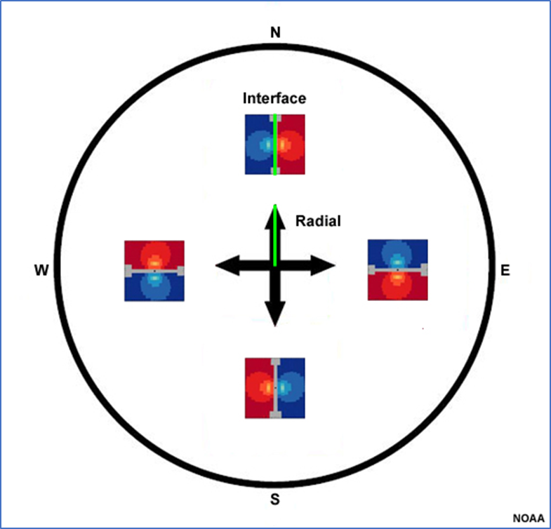

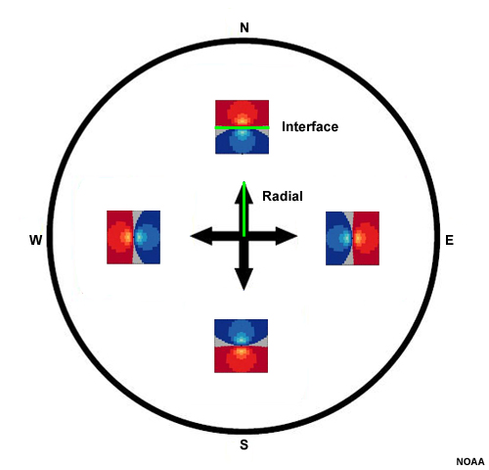
Orientation of the Doppler radial velocity couplet relative to the direction of the radar beam
Which couplets indicate rotation?
Couplet indicating rotation. Couplet indicating convergence (or divergence).

Slide 15
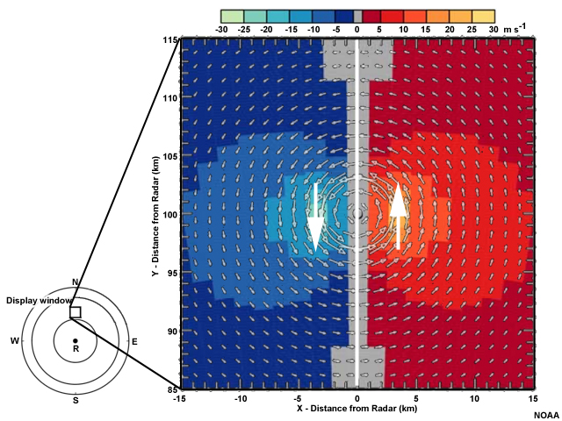
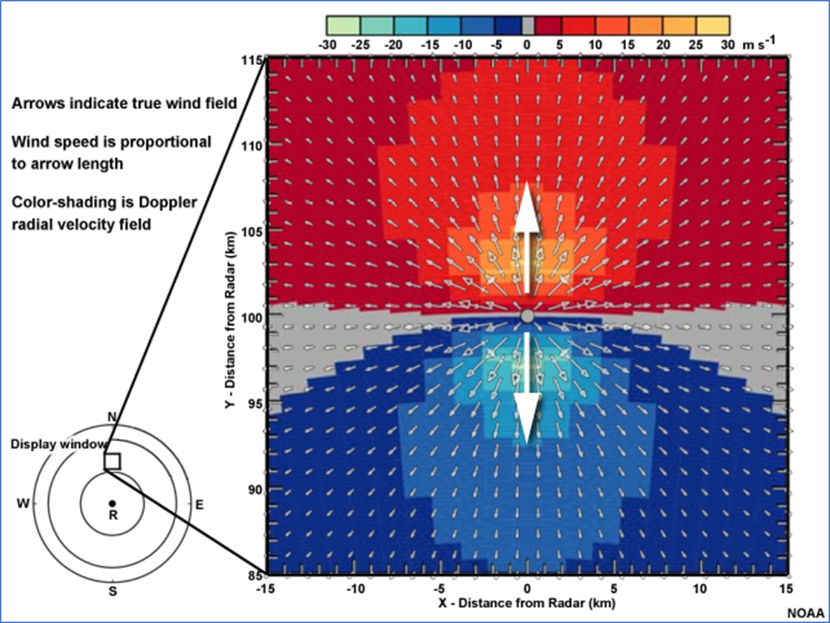
Orientation of the Doppler radial velocity couplet relative to the direction of the radar beam
https://www.nssl.noaa.gov/publications/dopplerguide/chapter4.php

Slide 16
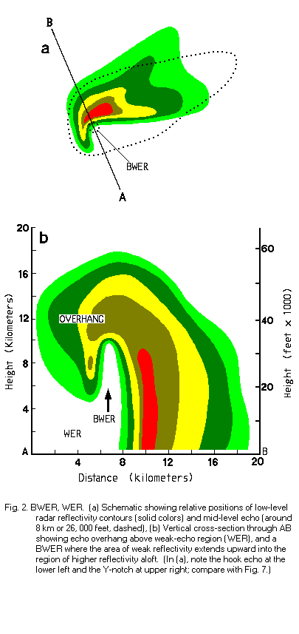
The bounded weak echo region (BWER), is a radar signature within a thunderstorm characterized by a local minimum in radar reflectivity at low levels which extends upward into, and is surrounded by, higher reflectivities aloft.
This feature is associated with a strong updraft.

Slide 17
Temporal courses of the satellite, radar and lightning characteristics and features of the storm (system)
The storm (system) was tracked –
Tracking is based on radar data: The 2-7 km CAPPI radar reflectivity fields were averaged and the studied radar cell (group) was tracked in this field.
For this cell along the track
  Separate the lightning strokes belonging to the studied cell (group) and count the total lightning strokes in 1 minute intervals.
  Collect the radar characteristic (Column Maximum Reflectivity (Cmax), Vertically Integrated Liquid (VIL), Constant Altitude Plan Position Indicator (CAPPI)) and features (bow, hook, Weak Echo Regions (WER), Bounded Weak Echo Region (BWER) echoes)
  Estimate vorticity or convergence from radial Doppler velocity couplets (when present).
  Collect the satellite characteristic (e.g. BT) and features (OT, ice plume, cold-ring, when present)
  Collect the severe weather reports, surface measurements

Slide 18
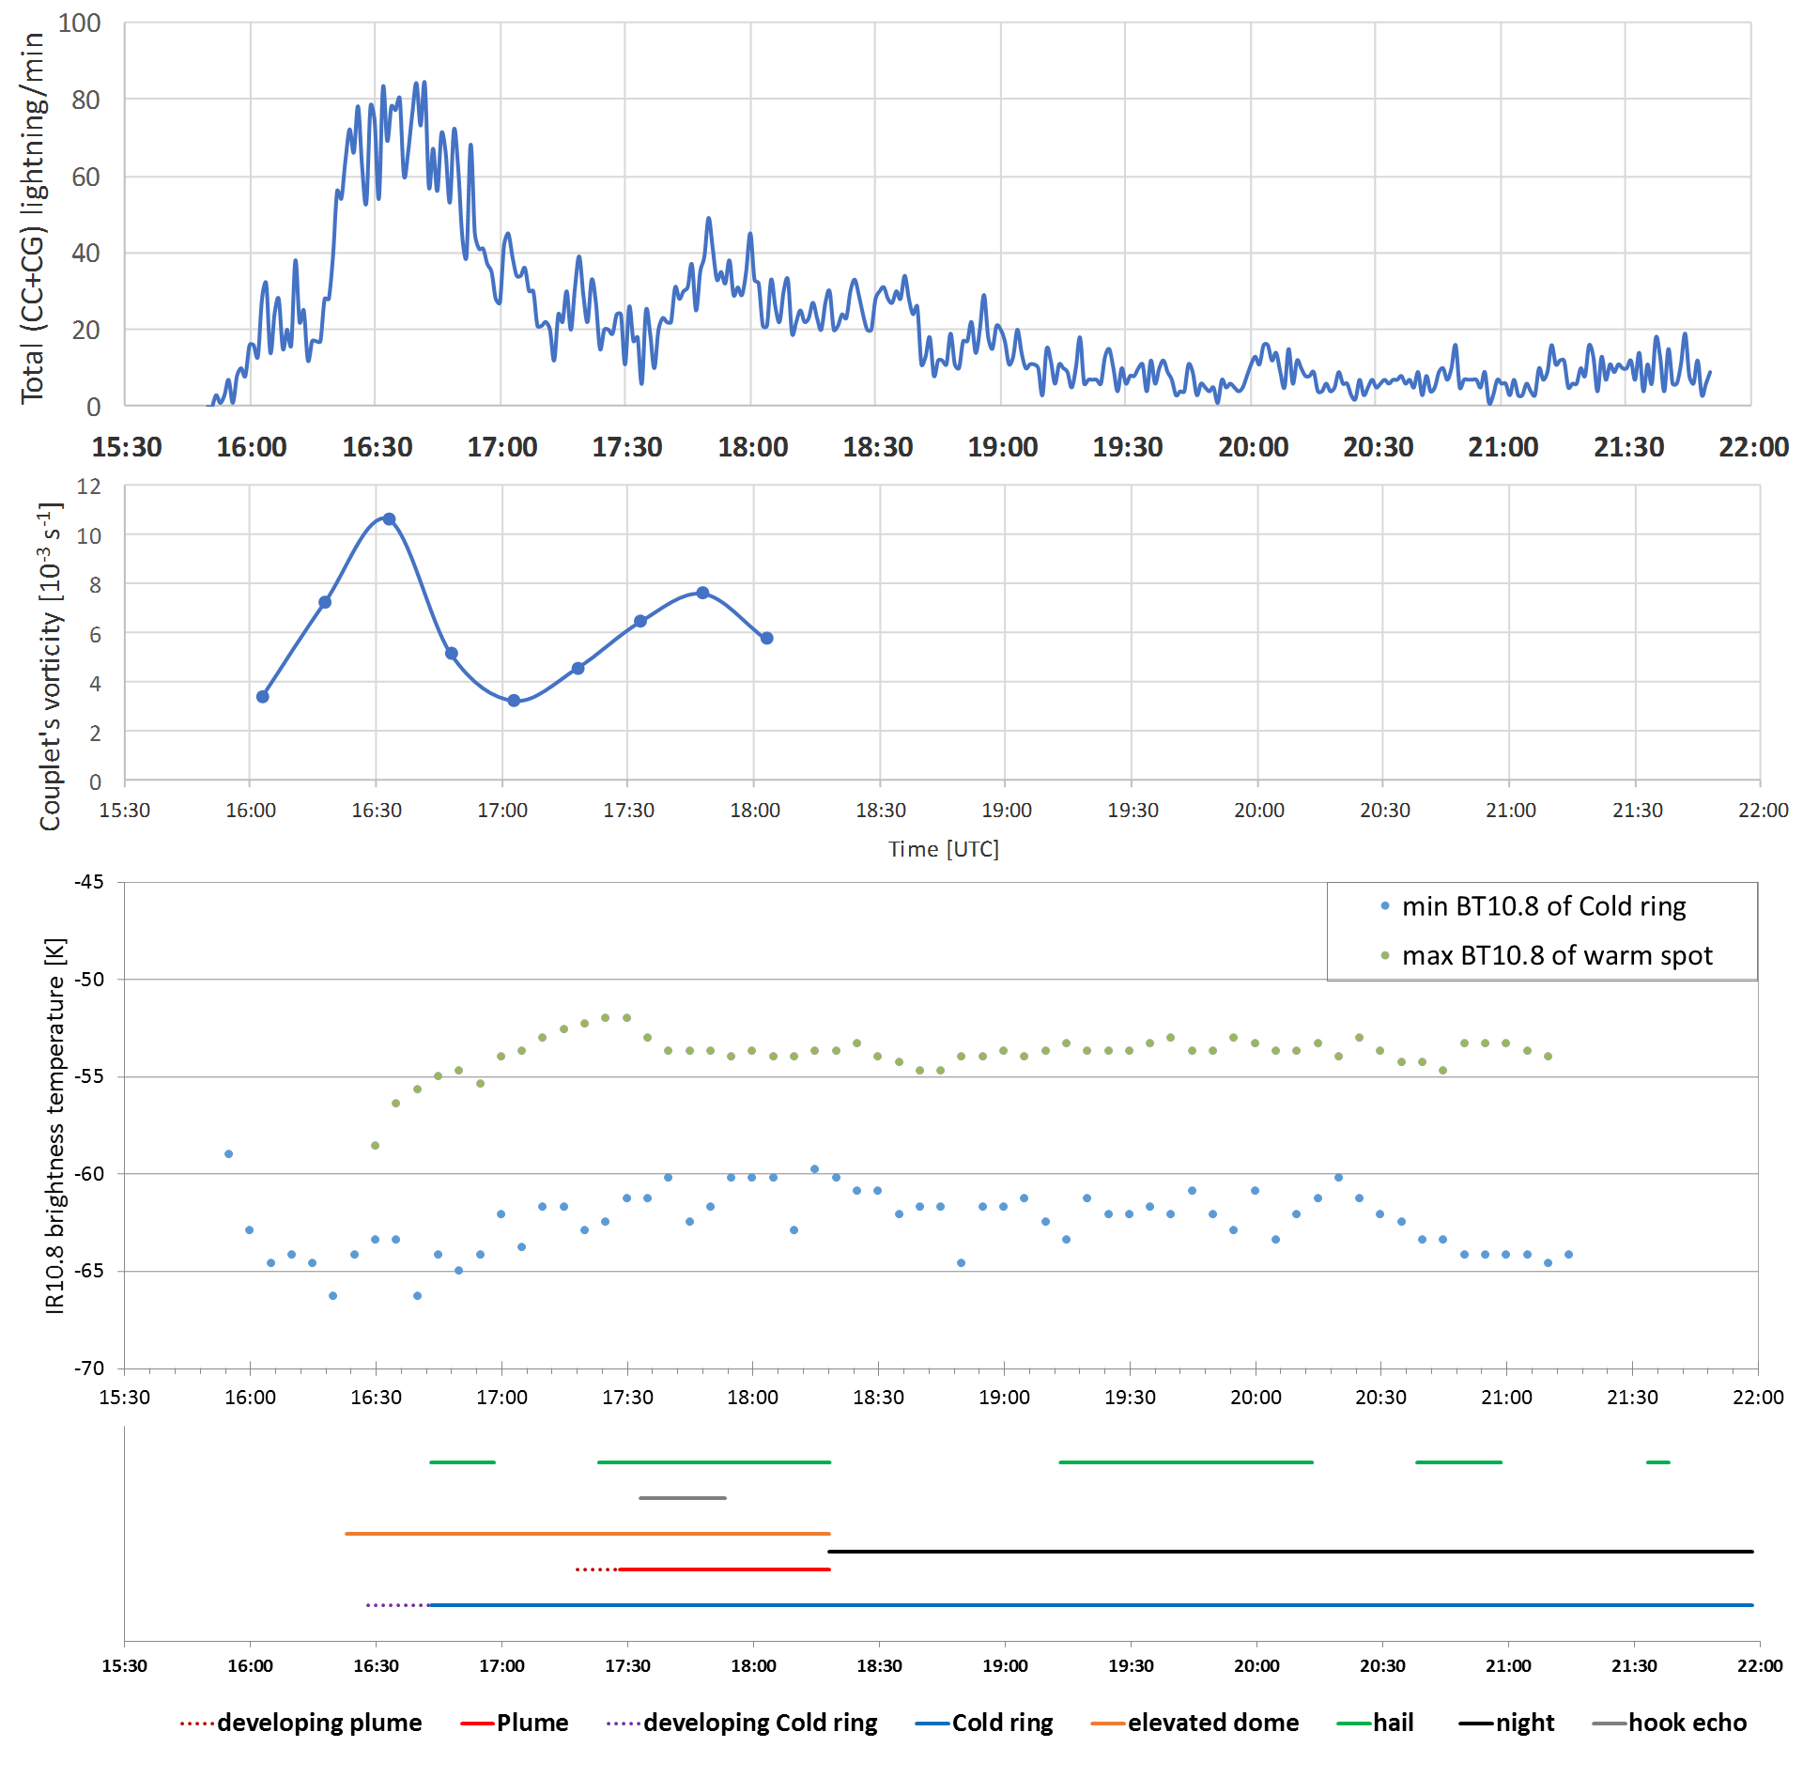
Correlation between lightning rate and estimated vorticity.
(Significant peaks in total lightning rate, when the mesocyclone strengthened, both are likely related to intensification of the storm’s updraft).
Cold ring formed just after the lightning jump at around the time of the first vorticity maximum.
(Cold ring forms in case of strong updraft.)
Lightning jump preceded the hail events.
Later, the number of total lightning discharges was lower, though, large hail was still reported.
  Lightning rate
  Estimated vorticity
  Satellite BT
6-10 K
  Events

Slide 19
Spatial distribution of the lightning density within the storm structure
How to characterize the storm structure?
Based (mainly) on radar data
To map the area of precipitation / (low/mid level downdraft) - 2km CAPPI field is used
How to map the (likely) area of updraft/mesocyclone?
  From satellite images – locations of overshooting tops (OT) –
                uppermost part of the updraft (at the cloud top level)
  From radar data –
    High (convective echo) at ~12 km CAPPI area
    ‘Mesocyclonic Vortex Signature’ in the Doppler velocity measurement, if present (mid-level info)
    WER/BWER echo region – likely location of mid-level updraft/mesocyclone. A so called WER parameter was defined to find the area of WER echoes (next slide).
OT
mature cell
CAPPI levels
CAPPI maxima
12km
Cell center
9km
Új cella
In case of strong windshear
↓
the storm, its updraft and the radar CAPPI maxima are tilted in the direction of the windshear
6km
3km
mesocyclone
Cmax

Slide 20
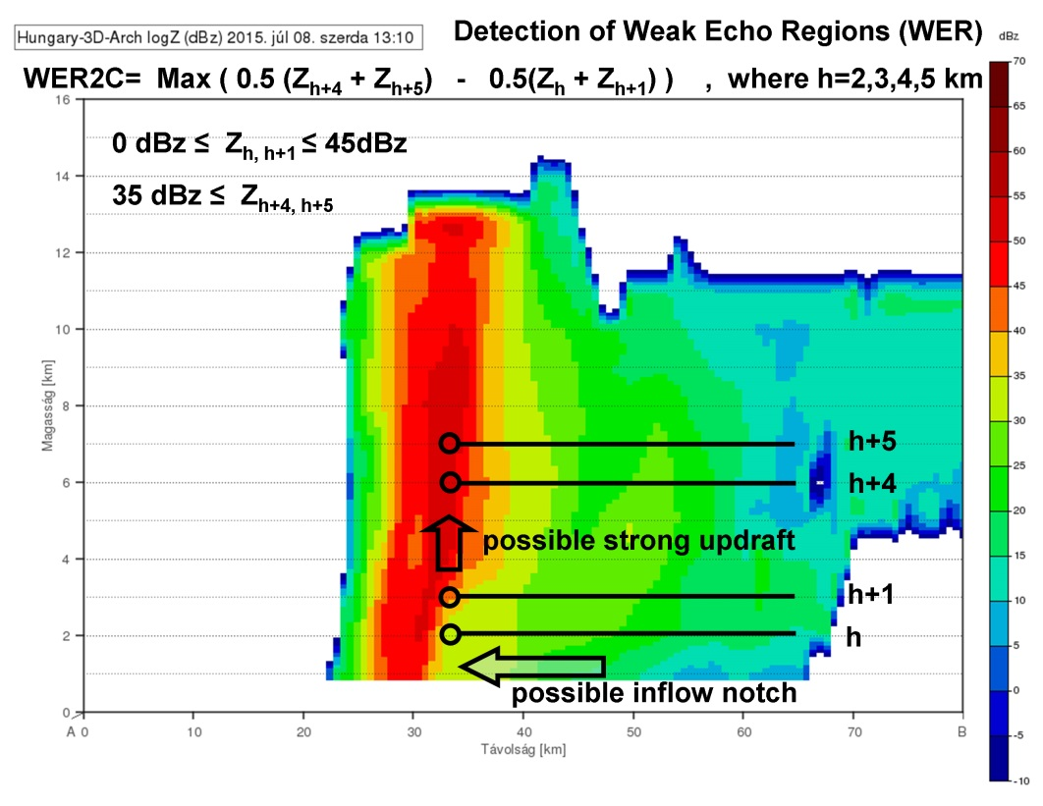
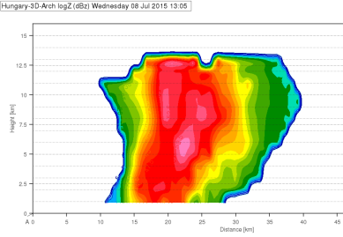
A parameter to find area of WER/BWER echo region - to highlight the areas where the radar reflectivity increases with height, which is typical for the updraft region
Vertical gradient of radar reflectivity

Slide 21
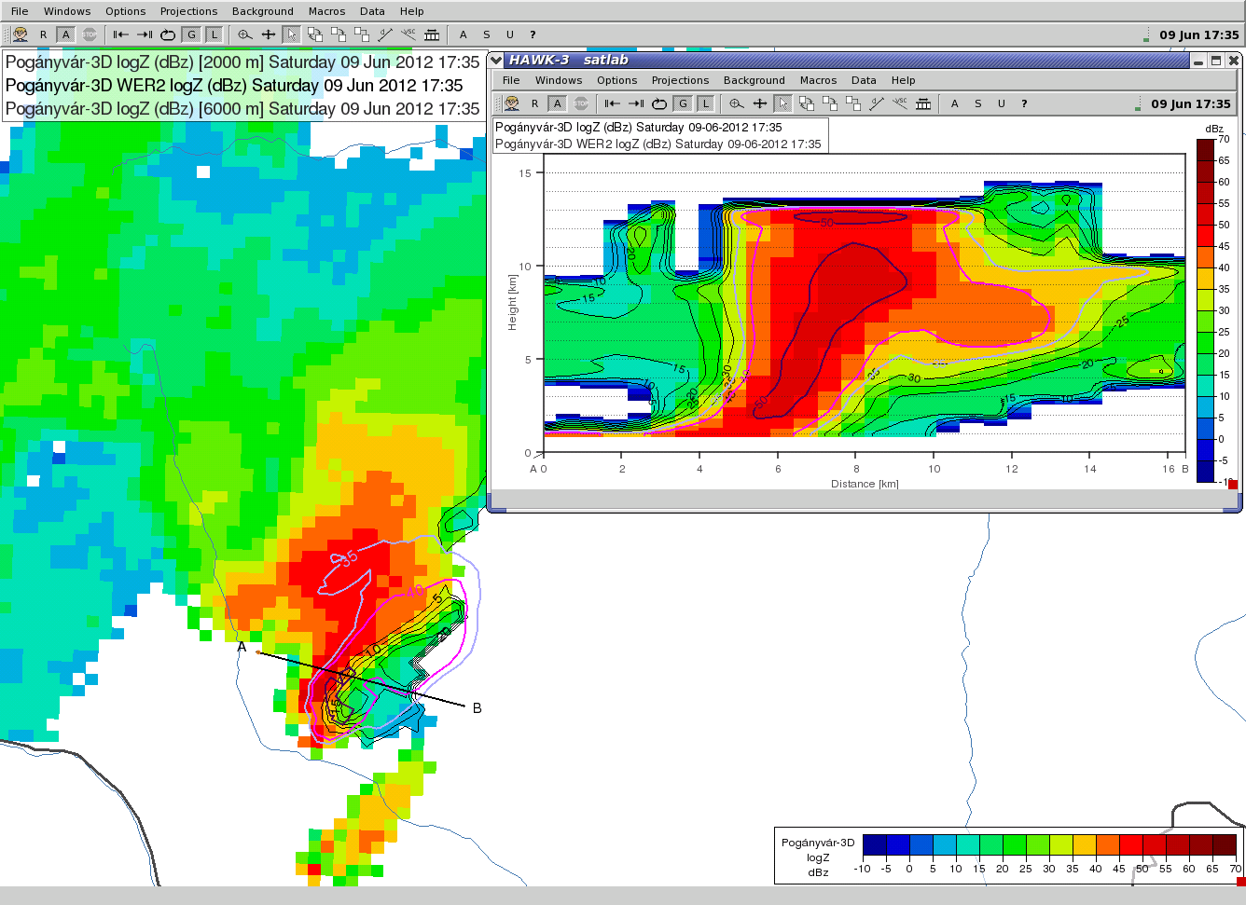
WER2c --- parameter helps to find WER/BWER echoes
  2 km CAPPI image - colour shades
  6 km CAPPI isolines – coloured isolines
  WER2 parameter – grey isolines
    Vertical cross-section along the AB solid black line
Example
Usefulness of WER2 parameter:
BWER echo in the vertical cross section across the area of high WER2c parameter

Slide 22
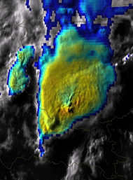
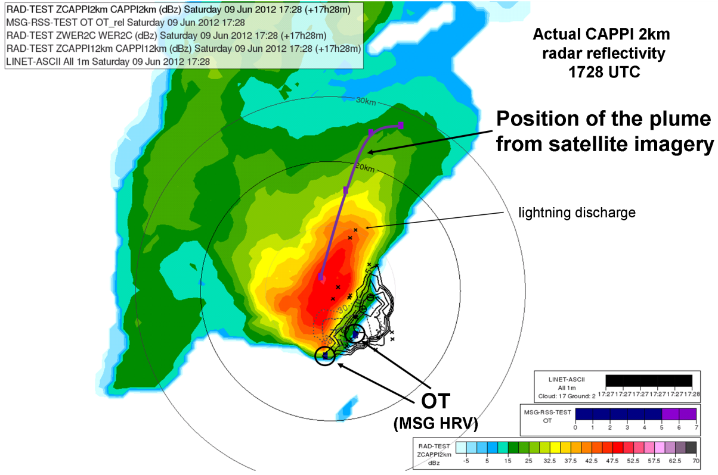

Example – storm structure visualisation using radar and satellite data
Precipitation/downdraft region - 2km CAPPI - colours
Updraft region
  WER2c parameters – black isolines
  12 km CAPPI – dotted isolines
  OTs (upper part of the updraft) from parallax shifted satellite data
Ice plume from parallax shifted satellite data
Lightning data
HRV/IR10.8 blended image
17:28 UTC
Ice plume
Overshooting top
Combination of radar, lightning and (parallax-shifted) satellite data.
The location of the ice plume’s source was over the centre of the storm, later it moved downstream (toward North-Northeast).
Well defined cold ring was present on the cloud top during several hours.
Ice plume was also definite.

Slide 23
Spatial distribution of lightning density within the storm structure
To calculate spatial distribution of lightning density we need longer time intervals (~30 min)
Convert everything into a storm-relative coordinate system
(to make easier temporal summation and averaging)
Choose interesting time intervals based on the lightning stroke rate temporal course
  Calculate the
  lightning density distribution
  averaged 2/12km CAPPI and WER2c parameter field to map the downdraft and updraft region in these time intervals

Slide 24
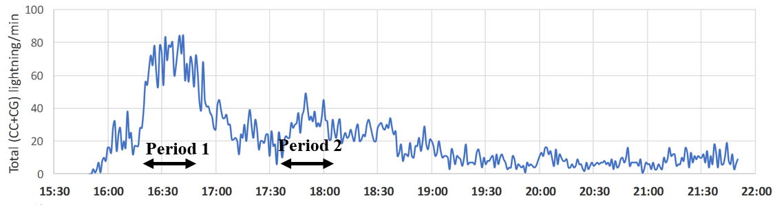
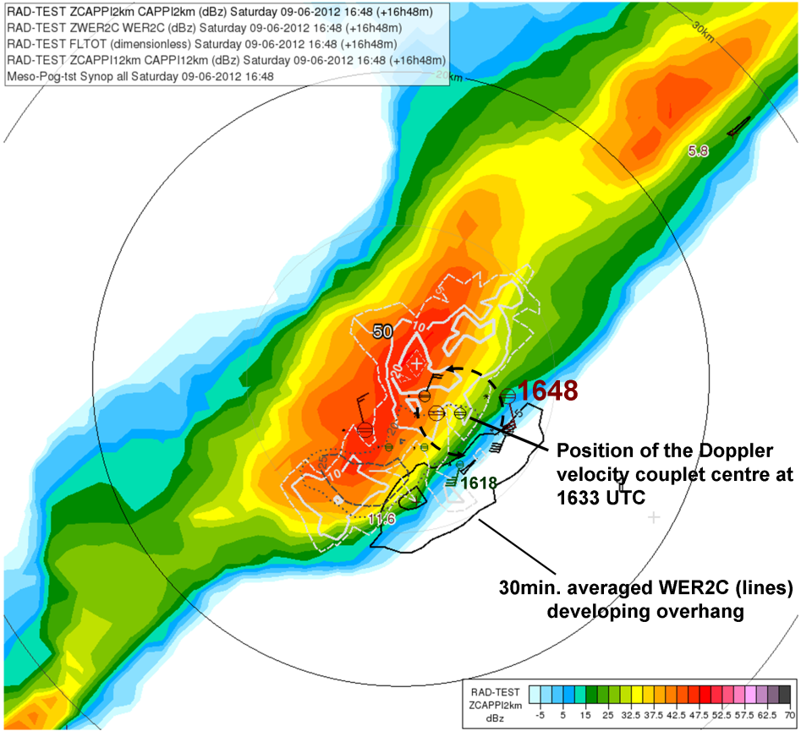
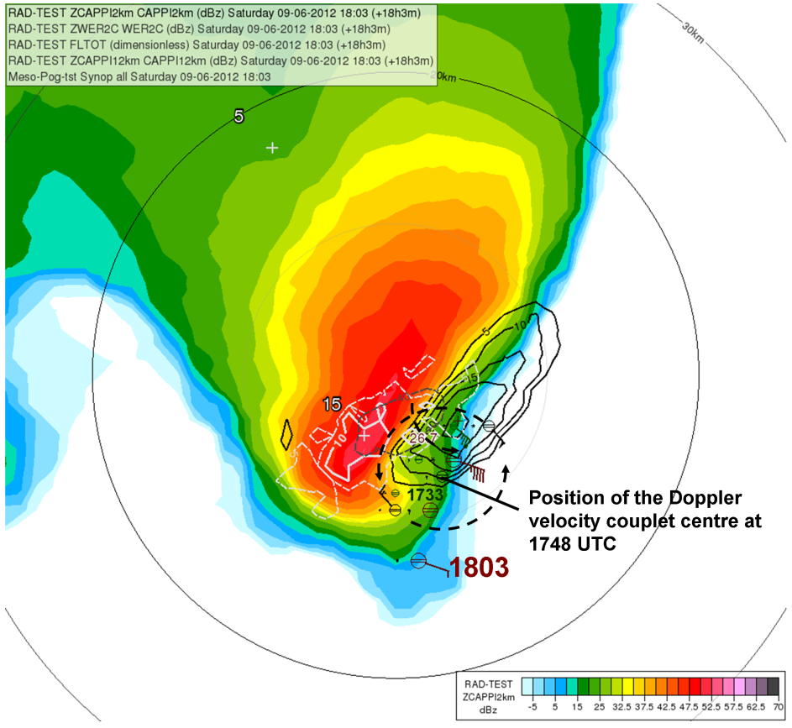
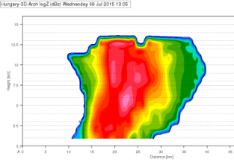
30 min. averaged 2km CAPPI radar reflectivity (color shades) (in a storm relative coordinate system)
Period 1:
1618-1648 UTC
(1st lightning rate maximum)
Period 2:
1733-1803 UTC
(2nd lightning rate maximum)
Total lightning density
(nr. of lightning / km²)
Total lightning density
maximum
High WER - well developed overhang
12 km CAPPI maximum
(probably the main updraft region)
12 km CAPPI maximum
The highest lightning density is mostly in the downdraft region
somewhat dislocated from the main updraft position.
Much less lightning was detected in the overhang area.

Slide 25
Outlines
Introduction
Five case studies
  Supercell, hailstorm (09 June 2012)
  Hybrid multicell-supercell storm, windstorm (08 July 2015)
  Tornadic storm (16 August 2010)
  Multicell storm and flashflood (31 July 2016)
  Single cell, short-lived local thunderstorm (23 July 2016)
Summary

Slide 26
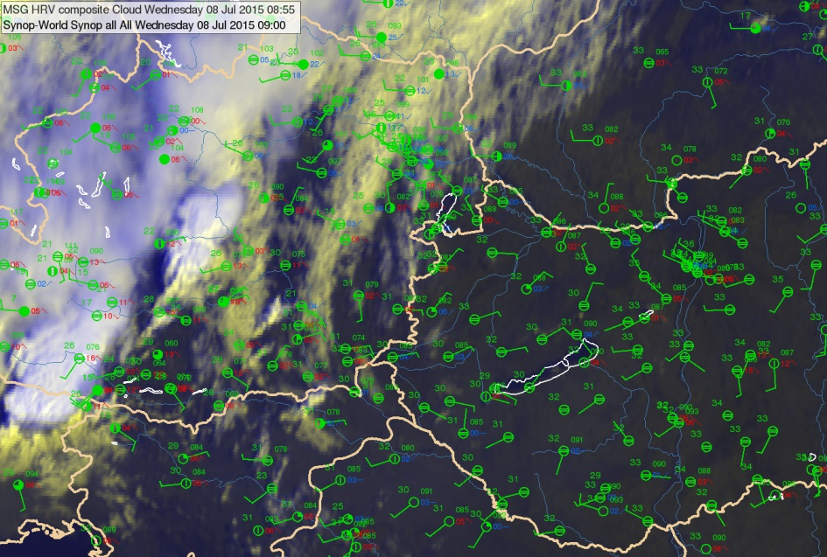
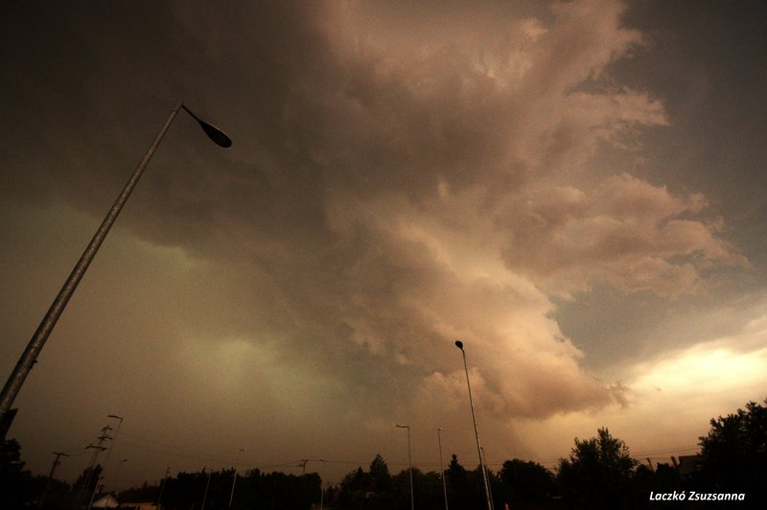
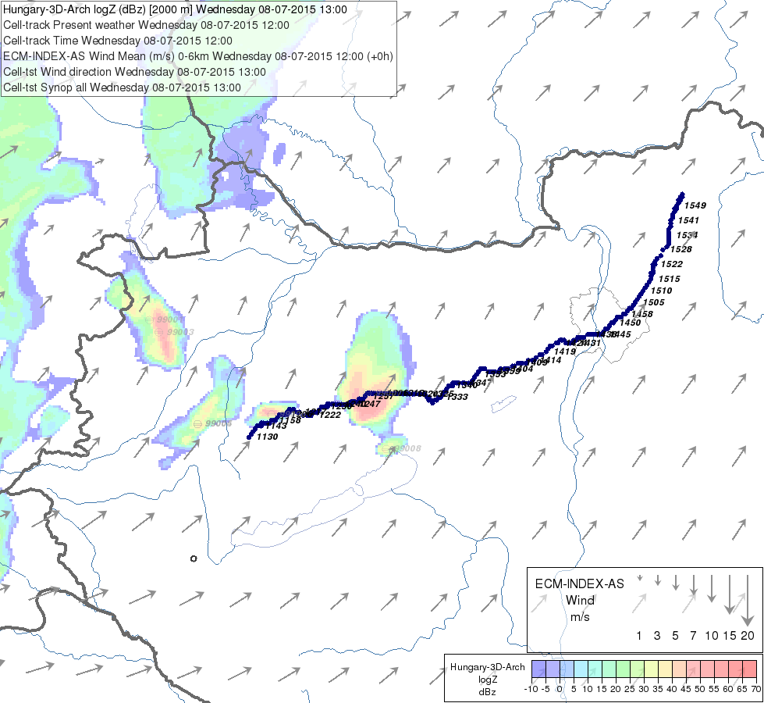
A hybrid multicell-supercell storm, windstorm
08 July 2015
Pre-frontal
convergence line
The thunderstorm developed ahead of a propagating cold front and moved along a pre-frontal convergence line.
It caused severe wind along its track (up to 35 m/s) + hail.
Cold front
H
L
H
Photo: Laczkó Zsuzsanna
Budapest
radar
The storm in its mature phase, west of Budapest.
Wind damage
Environment: Moderate-to-high wind shear, high humidity, moderate instability
Pogányvár
radar
Storm track

Slide 27
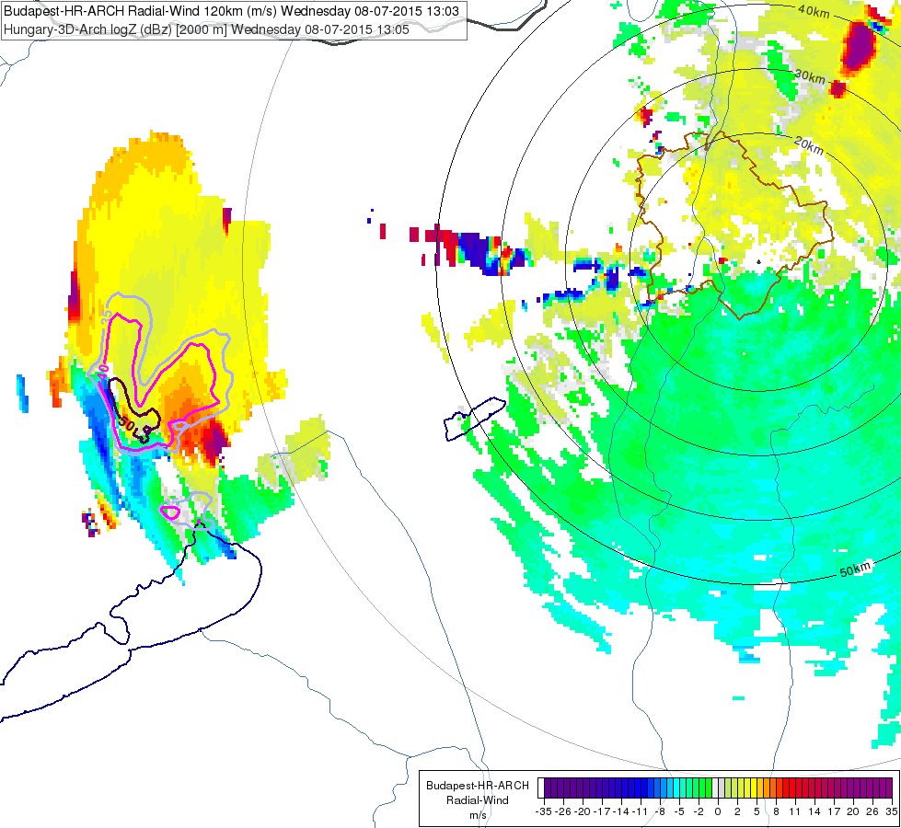
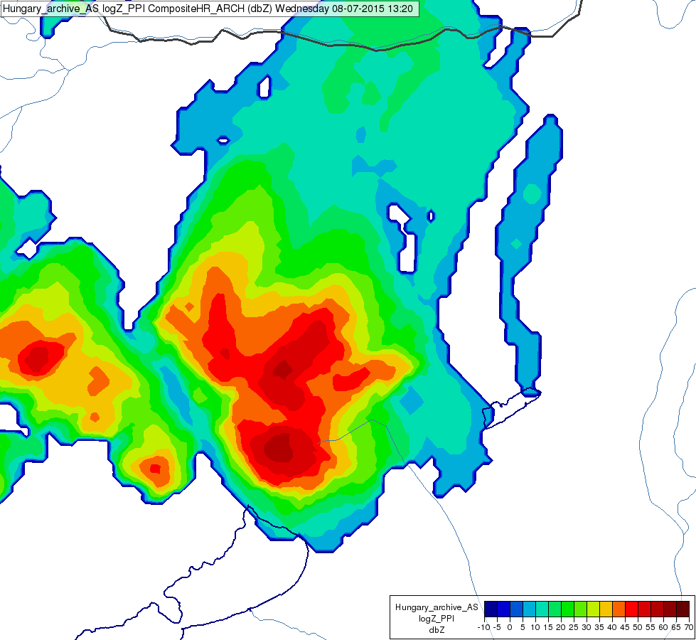

Hybrid supercell/multicell characteristics
1303 UTC
V-shape of reflectivity
radar
Frequent mergings with neighbouring cells
nr2
CMAX 1320 UTC
nr1
Doppler velocity couplets (min./max.)
CMAX 1305 UTC
PPI 1° radial Doppler velocity measurement
2 km CAPPI radar reflectivity isolines
original cell
V-shape (V-notch) in radar reflectivity
typical feature of some supercells
Several Doppler velocity couplets
Several mesocyclones formed

Slide 28
08.07.2015. windstorm
Comparison of the lightning rate to the previous case
High lightning rate
Number of Total strokes / 1 minute
Lightning jump
09.06.2012. hailstorm

Slide 29
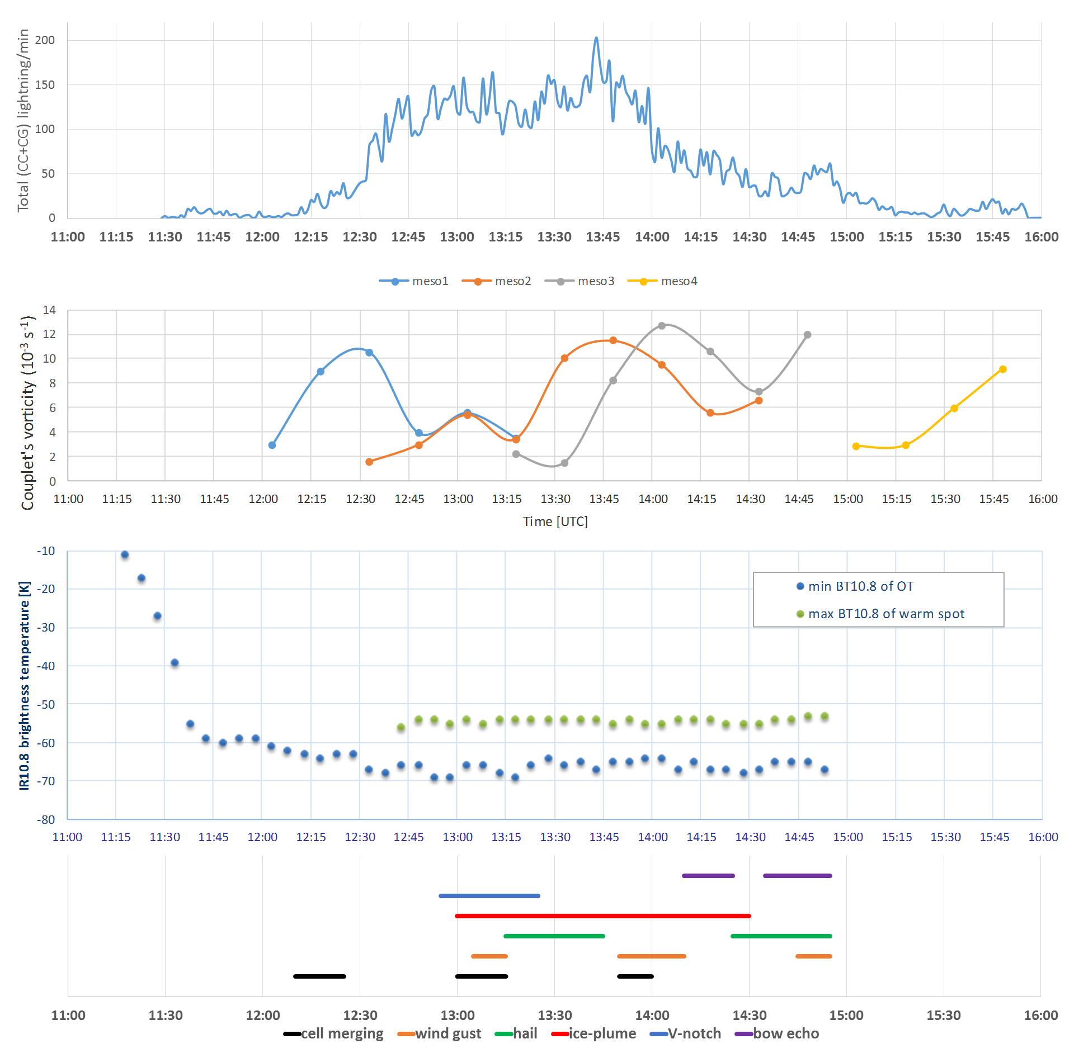
Increase in lightning rate is observed, when the rotation intensifies. (in periods of mesocyclone intensification).
First lightning maximum appeared before first reports on severe wind gusts (>25 m/s) and hail.
There is a remarkable drop of BT10.8 (6-16 K/15min) in the early phase of the storm.
The first lightning occurred in the early developing phase.
Cold ring formed just after the first steep increase of lightning rate and the first vorticity maximum.
Storm tracking → temporal courses
Lightning nr./1min.
High lightning rate
Estimated vorticity
Several cells
BT 10.8
9-15K
events
Notes:
Mit látunk még?

Slide 30

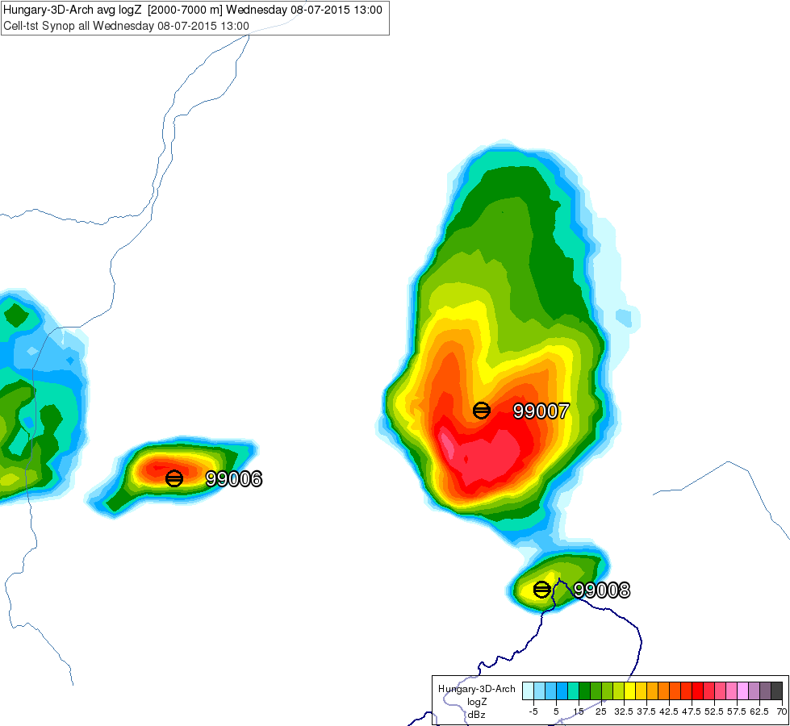
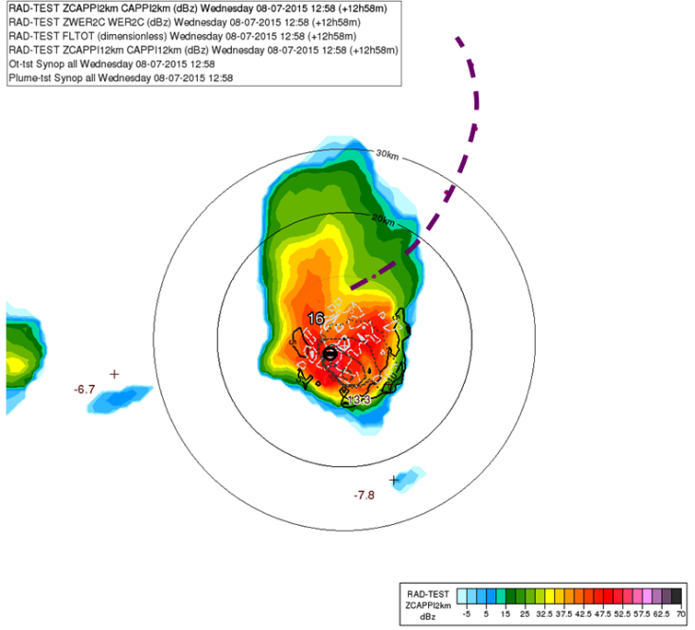
Storm-tracking
Gravity-centre of the 2-7km average radar reflectivity – „storm- and system centre” – is tracked
Location of the satellite, radar and lightning data are converted in the storm-relative coordinate system → Temporal and spatial distribution of satellite, radar, lightning data
Working in a storm-relative coordinate system we will be able to study the temporal evolution of the storm structure and the lightning density distribution within it.
plume
Storm’s „centre”
10 min. lightning
density
OT
10 min. average
radar reflectivity
at 2 and 12 km
Weak echo
(overhang)
Eulerian framework, moving storm
Lagrangian, fixed
Summation over time, averaging much easier
Overlapping of various parameters

Slide 31
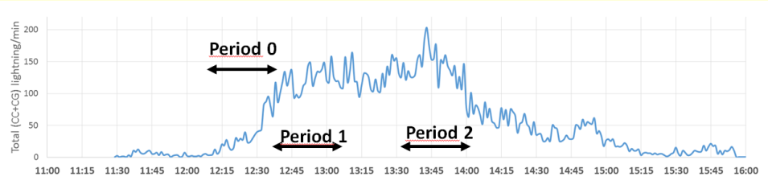
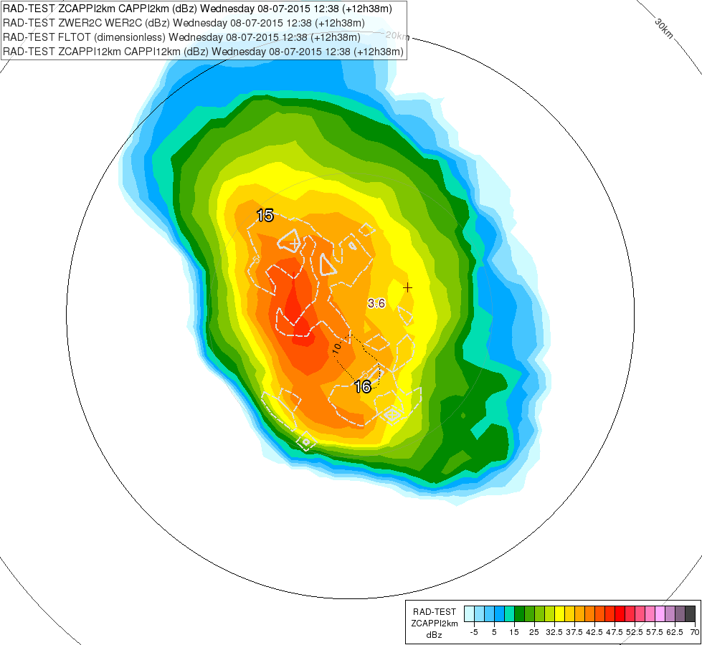
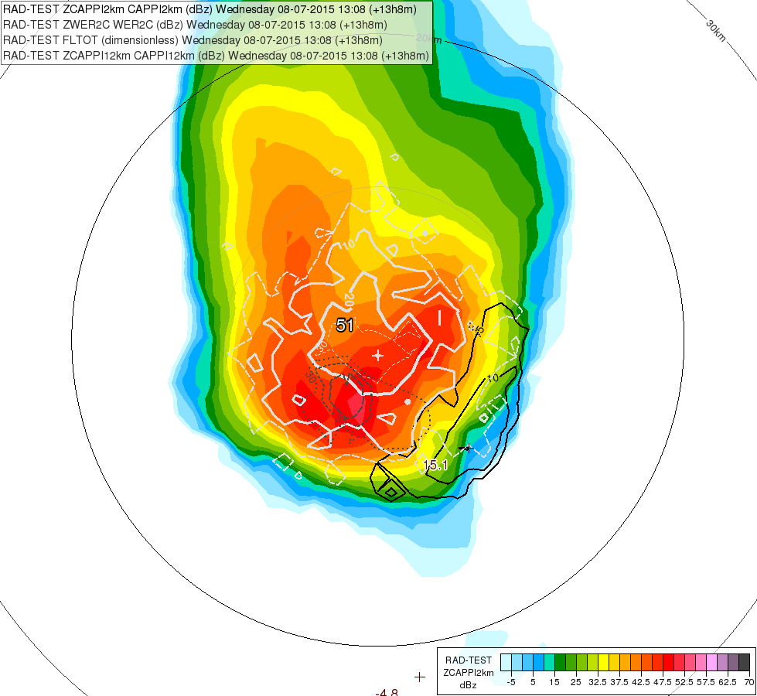
Storm structure
We studied 30 min. periods, interesting from the storm electrification point of view
Period 0:
Period 1:
Low-level
(2km) CAPPI
radar-reflectivity
1208-1238 UTC
(mesocyclone formation)
1238-1308 UTC
(V-notch shape)
Total (IC+CG) lightning density
(nr. of lightning / km²)
average WER2C
(overhang region)
12 km CAPPI maximum (weak)
12 km CAPPI maximum
Absence of overhang,
low reflectivity at upper levels (12km), lightning density increasing
The maximum lightning density does not coincide with the expected main updraft(s) and the overhang

Slide 32
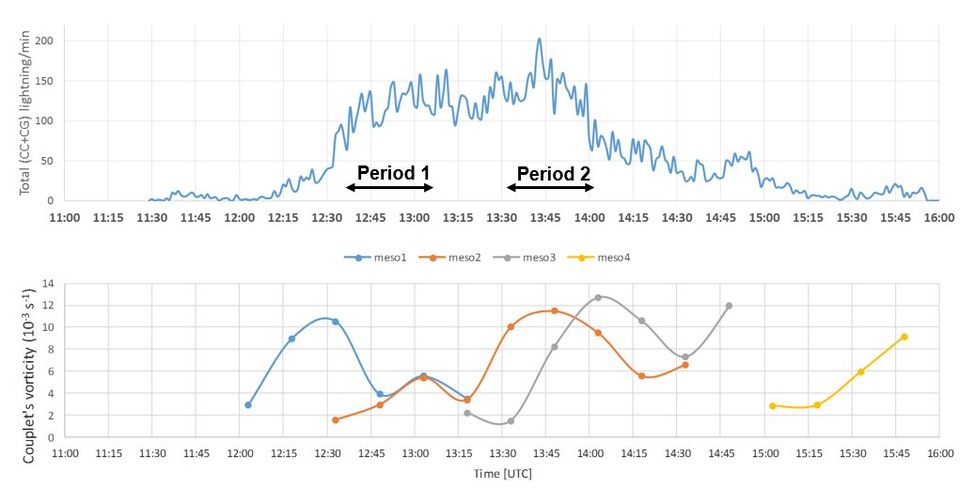
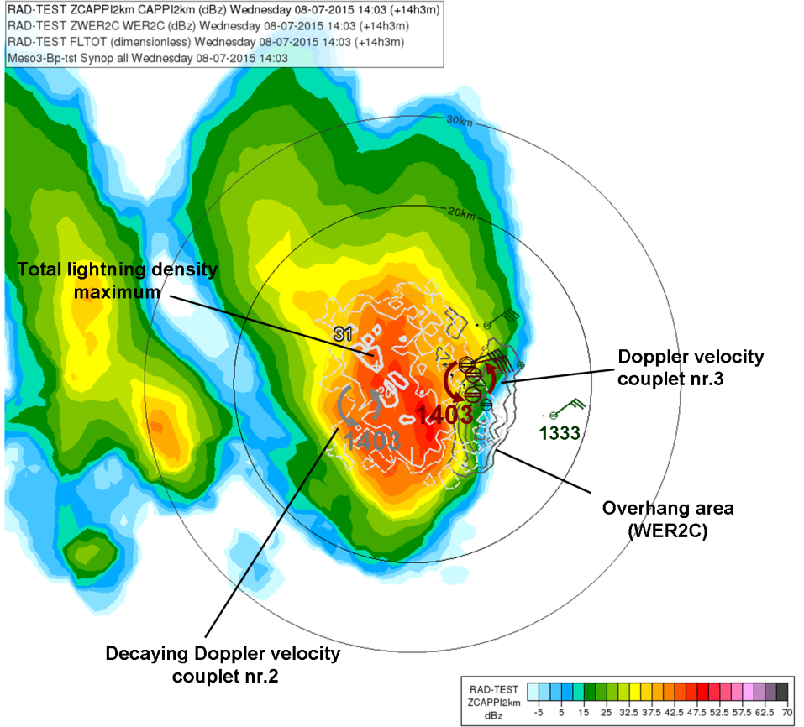
Period of
maximum lightning rate
Period 2:
13:33-14:03 UTC
(max. lightning rate)
High lightning density (many CGs) is coupled with high low-level radar reflectivity (hail, heavy rain, etc.) –
Much less lightning can be found in the overhang area (WER) and centre of the mesocyclonic circulation
The highest lightning density can be found somewhat off the main updraft.
The cell exhibited intense lightning activity, when also high WER2c and
strong mesocyclonic circulation were found

Slide 33
Outlines
Introduction
Five case studies
  Supercell, hailstorm (09 June 2012)
  Hybrid multicell-supercell storm, windstorm (08 July 2015)
  Tornadic storm (16 August 2010)
  Multicell storm and flashflood (31 July 2016)
  Single cell, short-lived local thunderstorm (23 July 2016)
Summary

Slide 34
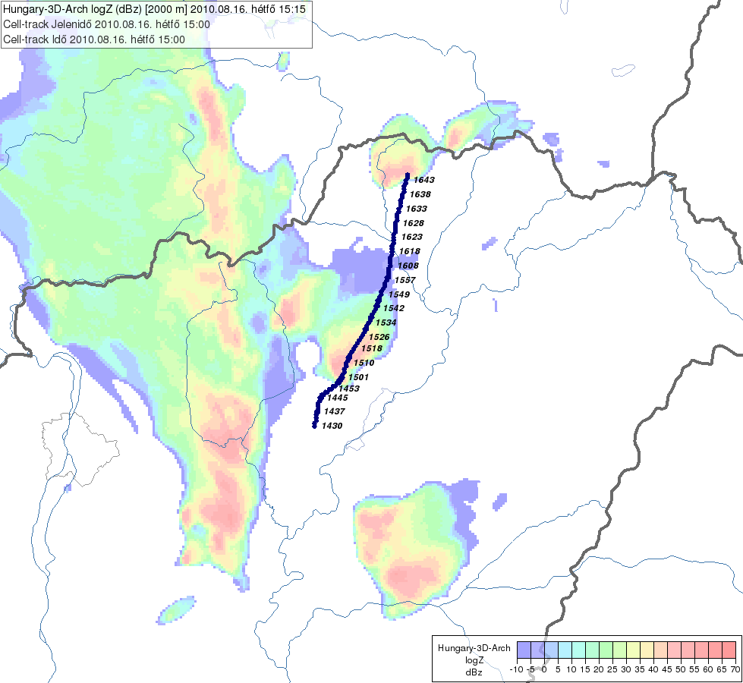

Tornadic storm, 16 August 2010
This day several convective systems formed over Hungary. One produced an F2 tornado.
The studied supercell initiated ahead of a cold front. Later it merged with the convective cloudiness of the front.
Cold front
Storm track

Slide 35


Environment ECMWF forecast for 15 UTC
MLCAPE (in J/kg) and wind at 925 hPa,
Convergence line
Moderate to high instability and humidity
0-6 km wind shear
Supercell Composite Parameter
Very high deep-layer wind shear - primary reason for the severity of the storms

Slide 36

Storm development
Severe storm features
15:15 UTC
Tornado - observed
Hook echo in 2 km CAPPI around the time when the tornado was observed
Cold front
HRV Cloud RGB and HRV/IR10.8 blended images.
The cold ring formed at around 14:55 UTC.
14:55 UTC

Slide 37
In the next slide we will compare the temporal courses of the lightning rates.
What do you expect? Max lightning rate of the tornado storm
  Larger than 200 stroke/min
  Between 80-200 stroke/min
  Less than 80 stroke/min
  No idea
Windstorm case (multicell-supercell storm)
Max lightning rate ~ 200 stroke/min
Hailstorm case (long lived supercell)
Max lightning rate ~ 80 stroke/min

Slide 38
Comparison of the lightning rate to the previous cases
08.07.2015. windstorm
Number of Total strokes / 1 minute
The total lightning rate was rather low before the supercell merged with the front.
Not the frontal, electrically more active storms were accompanied by the most spectacular weather phenomena.
09.06.2012. hailstorm
16.08.2010. tornadic storm
Merging with cold front
Tornado

Slide 39
The total lightning rate was rather low before the supercell merged with the front. - In severe storms this can be sometimes caused by microphysical processes.
Merging with cold front
Tornado
occurrence
The time period of the vorticity maximum is uncertain.
The vorticity maximum either coincides or precedes the total lightning rate maximum.
The cold ring formed earlier or at about the same time as the vorticity maximum.
The cold ring formed around the time when the tornado was observed.
The first point might be underestimated
6-10 K

Slide 40

Lightning density distribution within the storm structure
For the period 15:00-15:30 UTC (tornado occurrence):
Averaged 2 km CAPPI radar reflectivity (colour shades)
Averaged WER2c parameter (solid, dark lines)
Total lightning density (solid, light lines)
Well-pronounced hook-echo and
WER-echo region
The highest lightning density is in the western flank of the storm, somewhat shifted compared to the areas of maximum radar reflectivity.
Not many lightning strokes → lightning density distribution might be less accurate.

Slide 41
Outlines
Introduction
Five case studies
  Supercell, hailstorm (09 June 2012)
  Hybrid multicell-supercell storm, windstorm (08 July 2015)
  Tornadic storm (16 August 2010)
  Multicell storm and flashflood (31 July 2016)
  Single cell, short-lived local thunderstorm (23 July 2016)
Summary

Slide 42


Multicell storm and flashflood
31 July 2016
What happened?
A flash flood was reported in Komárom (H) and Komárno (SK).
Highest measured 24-h precipitation was 79 mm. 47 mm was reported within 1 h.
There was also 3-4 cm hail and damage due to wind.
The convective system developed along a convergence line ahead a cold front.
The propagation of the system was very slow during about 3 hours. At about the same location several cells initiated, developed and dissipated.
Slovak Republic
Flash flood
Hungary
Budapest
radar
Mesoscale analysis, 31 July 2016, 09 UTC
0
50km

Slide 43


Environment
TPW
ECMWF forecast 09 UTC
MLCAPE
MLCIN
Ingredients, which resulted in a flash flood:
Slow propagation
Quasi-stationary convergence: It was important to trigger new updrafts and also to maintain the convection over nearly the same territory.
Locally large CAPE (forecasted MUCAPE 1500-2000 J/kg)
Lot of low-level moisture (TPW)
Convective Inhibition (CIN) around: To inhibit other clouds to grow and share/destroy the potential energy sources.
Weak 0-6 km wind shear

Slide 44



11:33 UTC
Mid-level convergence was observed also by the Doppler radar velocity measurements
The arrow shows the location of the radar
MODIS VIS0.6465 11:25 UTC
Storm development
Courtesy of Cyril Siman (SHMÚ)
OT
OT
Photo of the storm 90 km from Northwest
at around 1130 UTC

Slide 45


Features indicating possible severity
SEVIRI 11:23 UTC
Unusually high lightning rate and the lightning density (comparable with the other cases).
long lived cold ring
The thin cirrus arch cloudiness (induced maybe by gravity waves in the stratosphere) spread from the OT position. Likely related to sudden strengthening of the updraft.
Photo taken around 11:55 UTC by Miroslav Šinger (SHMÚ)
At the time of the lightning rate and the convergence intensity maxima (see later)

Slide 46
Comparison of the lightning rate to the previous cases
08.07.2015. windstorm
Number of Total strokes / 1 minute
Very high lightning rate
Sudden increase of lightning rate
31.07.2016. multicell system
09.06.2012. hailstorm

Slide 47
The lightning activity period started already in the developing phase of the storm before its top reached the tropopause.
Between 11:00-11:10 UTC there was a sudden increase in total lightning rate likely due to strong updraft
Cold ring formed at just after the strengthening of lightning rate and convergence, likely due to strong updraft.
The maximum of the total lightning rate coincided with the maximum of the convergence.
The first intense lightning activity preceded the heavy rain and (more or less) coincided with hail reports.
convergence
3-12 K
Three major cells evolved and decayed during the severe weather period.

Slide 48

The first lightning rate increase was possibly related to appearance of large hail (increase in Colum maximum radar reflectivity areal sum after 10:45 UTC).
The later lightning rate maximum correlated with mid-level convergence (strong updraft).
At the time of the maximum lightning activity, there were no echoes exceeding 55 dBz, although there was a peak of reflectivity higher than 45 dBz.
This suggests that the charge was produced in environment with (many) graupels or small hail but less (or absent) large hail.
Many graupels but absence of large hail?

Slide 49



The highest lightning density (exceeding 50 lightning/km²) among the studied cases.
Period 1:
1045-1115 UTC
(lightning rate increase,
hail reported )
Period 2:
1145-1215 UTC
(maximum lightning rate)
high lightning density
12:18UTC
11:18UTC
Max. 12 km
CAPPI
convergence at the
SW flank of the storm
at 12:03 UTC
high lightning density
convergence at the
SW flank of the storm
(11:03 UTC, 2.5 km height)
WER area (storm tilted to SW)
The lightning density is collocated with the precipitation area.
We could not map the updraft region: 1) No rotation, 2) Location of OT were hard to observed on satellite imagery, 3) High level CAPPI was not strong, 4) There is no stable, strong WER area, no strong vertical gradient of radar raflectivity.

Slide 50
Outlines
Introduction
Five case studies
  Supercell, hailstorm (09 June 2012)
  Hybrid multicell-supercell storm, windstorm (08 July 2015)
  Tornadic storm (16 August 2010)
  Multicell storm and flashflood (31 July 2016)
  Single cell, short-lived local thunderstorm (23 July 2016)
Summary

Slide 51


Short-lived, local thunderstorm at Balaton
23 July 2015
Synoptic situation
Thunderstorms formed in a warm pre-frontal airmass.
Environment
Very high TPW (> 30 mm).
very unstable environment
dry mid-levels
no persistent low-level convergence
very low wind shear,
Most moist and unstable case from the 5 studies cases
Single thunderstorm with high lightning activity (two injuries). Rapid development and dissipation, short lifetime, slow motion
Wind gusts up to 15 m/s
Notes:
A radar képen mit mutat a piros nyíl? Gust-ot?

Slide 52
08.07.2015. windstorm
Comparison of the lightning rate to the previous cases
Number of Total strokes / 1 minute
09.06.2012. hailstorm
23.07.2015. single cell
16.08.2010. tornadic storm

Slide 53
No severe storm characteristics (e.g. WER, Cold ring) in radar or satellite data.
The lightning intensity was sometimes significant but short-lived and much lower compared to other presented cases.
The lightning activity period started already in the developing phase of the storm.
The lightning rate maximum preceded the strong windgust by 5 min.
The maxima of the lightning stroke rate and radar reflectivity, and the minimum of IR10.8 cloud top temperature roughly coincided.
Under some conditions, even such thunderstorms can be hazardous due to sudden and fast development (high instability supports strong vertical motions).
There was not enough strokes to calculate lightning density

Slide 54
Outlines
Introduction
Five case studies
  Supercell, hailstorm (09 June 2012)
  Hybrid multicell-supercell storm, windstorm (08 July 2015)
  Tornadic storm (16 August 2010)
  Multicell storm and flashflood (31 July 2016)
  Single cell, short-lived local thunderstorm (23 July 2016)
Summary

Slide 55
Conclusions (based on these 5 cases)
The lightning activity started already in the developing phase of the storms’ life-cycles.
The lightning rate can be high or relatively low in supercells. (Lightning activity depends not only on the updraft strength but on the microphysics as well.)
The lightning rate can be higher in a multicell system than in a supercell.
We found sudden increase of lightning rate in 2 supercell cases and in the multicell case.
The course of lightning rate correlates with the course of vorticity estimated from radial Doppler velocity measurements - in supercell cases with high lightning rates (2 cases). (We found significant peaks in total lightning, when the mesocyclone strengthened, both are likely related to the intensification of the storm’s updraft).
Cold ring formed just after the sudden increase of lightning rate (2 supercell + multicell cases) at around the time of the first vorticity maximum (3 supercell cases). (Cold ring is also related to strong updraft.)
The course of lightning rate showed some correlation with the course of the convergence intensity in the case of the multicell system. Likely common reason is the updraft strengthening

Slide 56
Conclusions cont.
In periods of lightning intensification we find other characteristics of severe storms: (like Doppler velocity signatures, OT-s, cold rings and ice plumes, WER echoes) in the supercell cases + multicell case.
High lightning rates often can be found prior to observed severe weather (hail, windgust, heavy rain). (Note, that the time of the severe weather events were often uncertain, for example in case of hail, as we worked with ESWDB report (+ high radar VIL data) and not with hail pad data.)
There is no simple relation between lightning rate and hail on the ground. In the later stages we can find large hail with relatively low lightning rate and no hail with high lightning rate.
The lightning density of a supercell is not necessarily higher than in a non supercell severe weather. The highest lightning density was found in the multicell system.
The highest lightning density mostly occurred in high radar reflectivity area at 2 km (heavy precipitation/hail). - In supercells, this maximum can be dislocated from the strongest echoes at higher (6, 12 km) levels. Much less lightning was detected in the overhang areas with high WER2c (3 supercell cases).
For more general conclusions - More cases needed

Slide 57


Thank you for your attention!
putsay.m@met.hu

Slide 58
References
Simon, A., Putsay, M., Zsófia Kocsis , Zs. and Ildikó Szenyán, I. (2016): Analysing a convective event (09 June 2012) with satellite, radar and lightning data, Convection Working Group workshop, Florence, Italy, 4-8 April 2016.
Betz, H.D., Schmidt, K., Laroche, P., Blanchet, P., Oettinger, W.P., Defer, E., Dziewit, Z., and Konarski, J., 2009: LINET— An international lightning detection network in Europe. Atmos. Res. 91, 564–573.
Kaňák, J., Jurašek, M., 2004: Tracking algorithm for Meteosat data as a CEI nowcasting tool. The 2004 EUMETSAT Meteorological Satellite Conference Proceedings. Darmstadt, 360
König, M., Tjemkes, S. A., Kerkmann, J., 2001: Atmospheric Instability Parameters Derived from MSG SEVIRI Observations. 11th Conference on Satellite Meteorology and Oceanography.
M. Setvák, D. T. Lindsey, P. Novák, P. K. Wang, M. Radová, J. Kerkmann, L. Grasso, S-H Su, R. M. Rabin, J. Šťástka, Z. Charvát., 2010: Satellite-observed cold-ring-shaped features atop deep convective clouds. Atmos. Res., 97 (2010), 80–96.
Wang, P. K., 2007: The thermodynamic structure atop a penetrating convective thunderstorm. Atmos. Res., 83 (2007), 254–262.

Slide 59


Complex case study of a severe storm
Main emphases on remote sensing data : satellite, radar, lightning
Technical information on the applied remote sensing data
Satellite
  METEOSAT SEVIRI RSS (5 minute data)
  Lightning – data of LINET network - operationally used at OMSZ
  European Lightning Detection NETwork (~130 sensors in Europe, 7 sensors in Hungary )
  every stroke: time [ms], location, height, type (CC, CG), current amplitude estimation [+/-kA], location uncertainty
  It detects at low frequency (very long wave)
  It discriminates CC from CG strokes according their heights (software based on high precision time measurement)
                (ratio of CC and CG in Hungary ~ 1:1)
Hungarian radar system
  Three/four Doppler dual-polarization DWSR radars working at 5,3 cm wavelength
  5 minute reflectivity data at 10 elevation angles (0.0, 0.5 ,1.1, 1.9 ,3.0 ,4.7, 7.0, 10.0, 14.2, 20), in 240 km radius area
  15 minute wind measurement in 5 elevation angles (1.1, 1.9, 3.0 ,6.5 ,14.0), in120 km radius area (3 minute shift)
  Volume data→ products with 1x1 km resolution
  For each radar: PPI, CAPPI, Cmax, VIL, ETOPS
    + Hungarian composite images (Cmax, VIL, ETOPS)
  Doppler wind measurements

Slide 60

Vorticity or convergence can be estimated from radial Doppler velocity couplets (when present).
Estimation of couplet’s vorticity, mostly at 2-3 km height (PPI data)

Slide 61
For each cases – thunderstorm type
What happened?
Synoptic situation
Convective environment
Severe storm features in lightning, satellite and radar data, if any
Temporal course of lightning, radar satellite, parameters and features, weather reports, surface measurement …
Spatial distribution of lightning density within the storm structure (in some time periods)

