Slide 1
Polarstern &
Satellite data
Mark Higgins

Slide 3
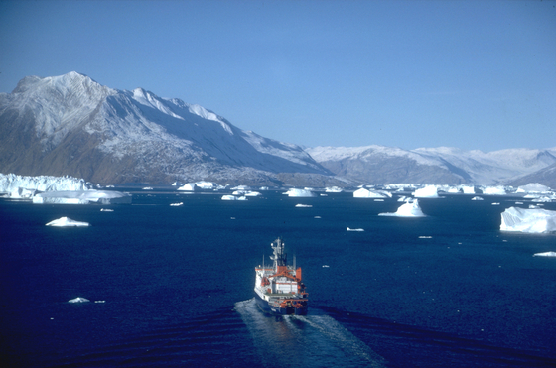
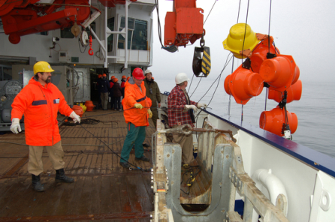
Images from the Alfred Wegener Institute for Polar and Marine Research
[Hannes Grobe and Ralf Roechert]

Slide 4
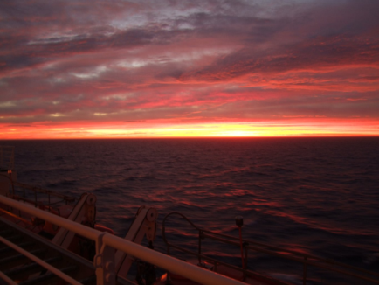
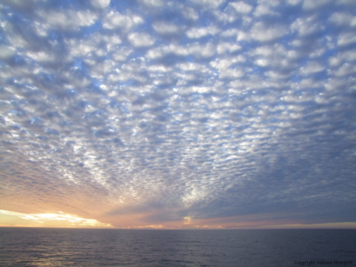
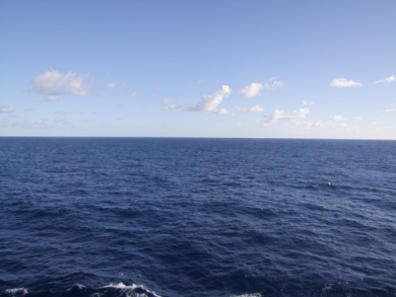

Slide 5
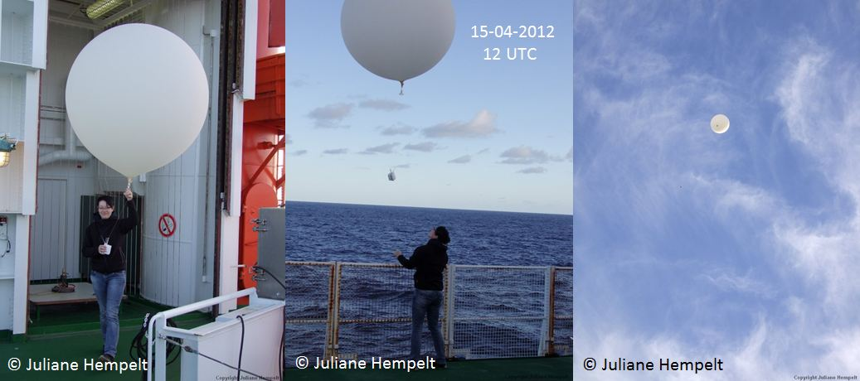

Slide 6
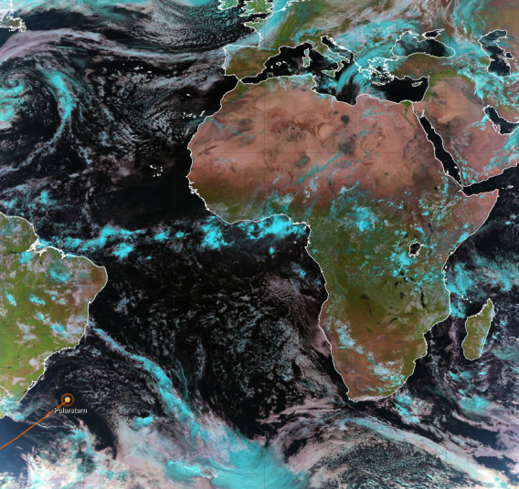
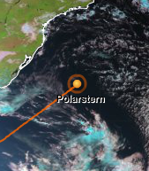
2012 April 17 - 12UTC
Natural Colour RGB
Polarstern SE of Brazil

Slide 7
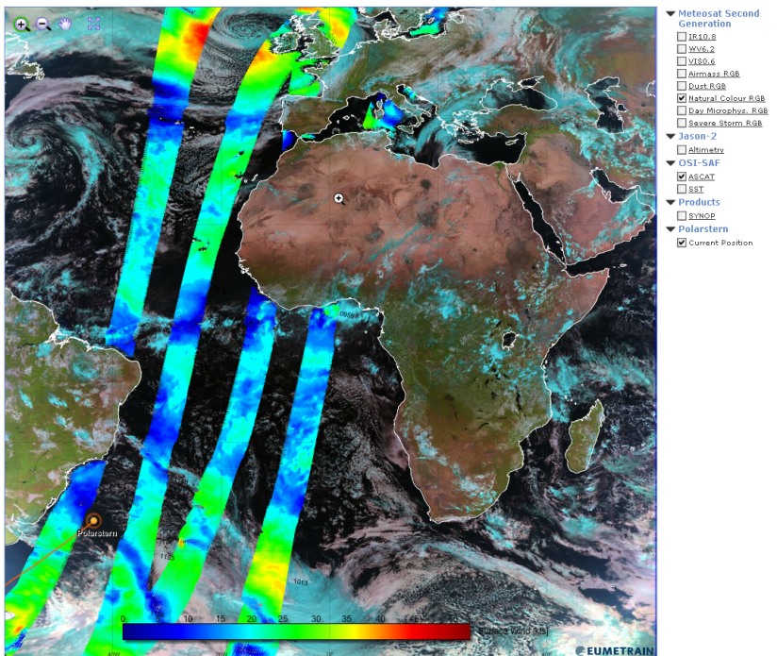
April 17 12UTC

Slide 8
How may orbits can you see?
1 2 3 4 5 6
April 17 12UTC

Slide 9
How may orbits can you see?
1 2 3 4 5 6
Two orbits with a nadir gap between the left and right beams of the ASCAT instrument.
April 17 12UTC

Slide 10
Descending or ascending?
April 17 12UTC

Slide 11
Descending – the satellite moves east to west relative to the Earth’s surface.
For Metop these are the daytime passes
April 17 12UTC

Slide 12
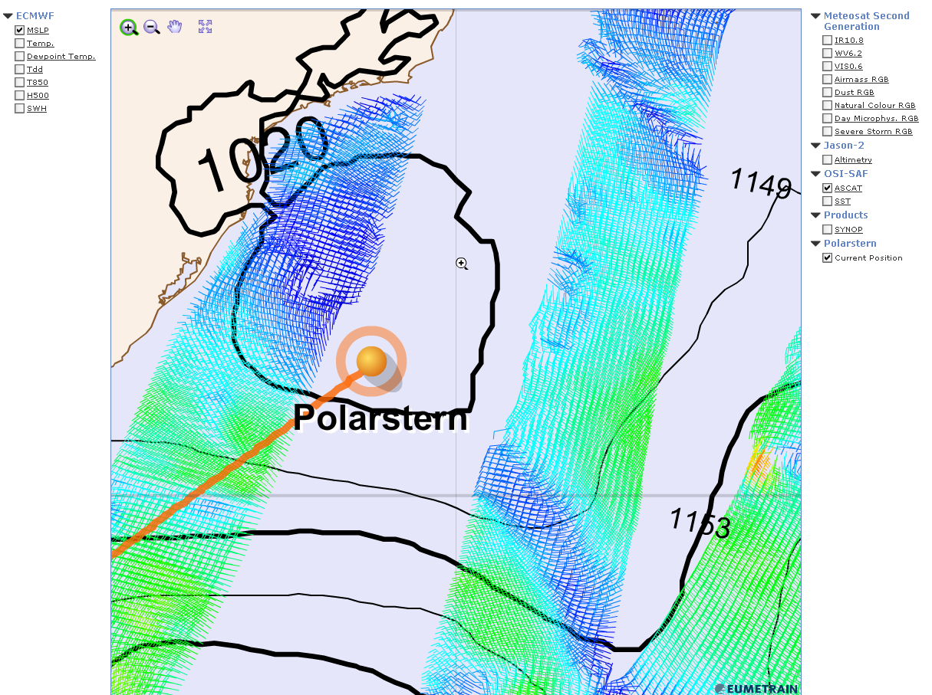
Metop-A
Sensing times
April 17 12UTC

Slide 13
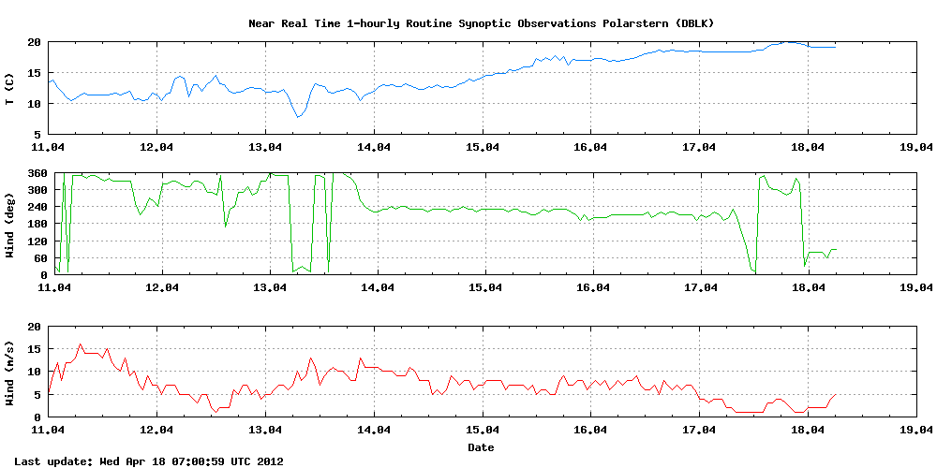

Slide 14
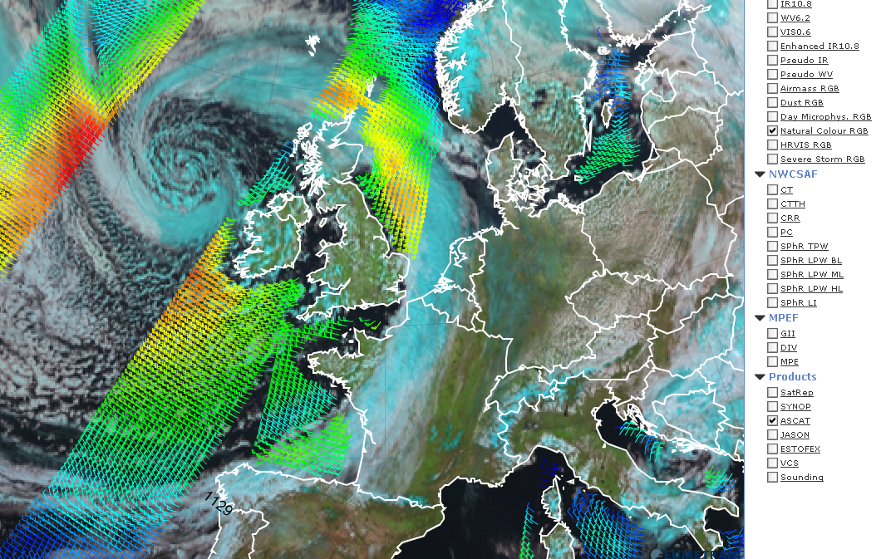
April 17
12UTC

Slide 15
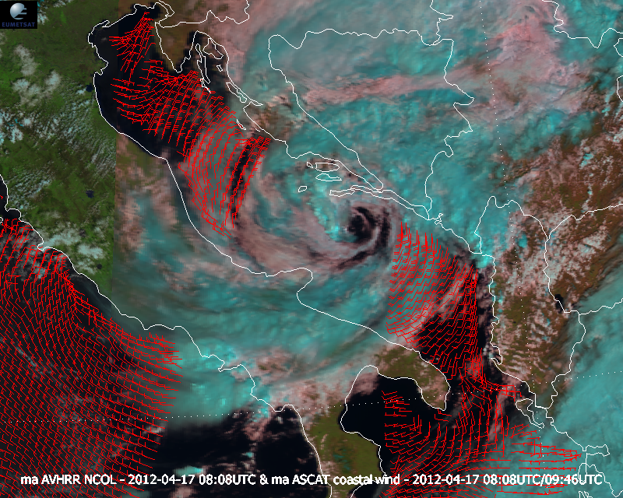

Slide 16
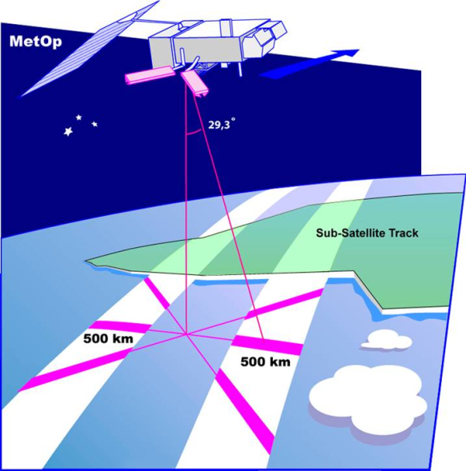
ASCAT Geometry
C-band radar (5.25GHz)
5.7cm Wavelength
3 x 2.2m Antenna
Active instrument: send and receive
What happens when the radiation hits water?

Slide 17
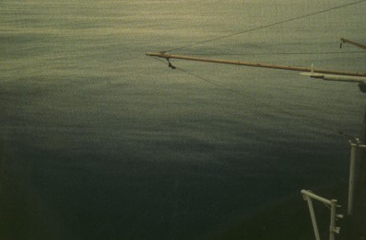
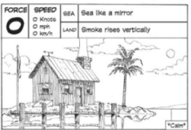
Incoming radar
Reflected radar
No energy is scattered back to the source

Slide 18
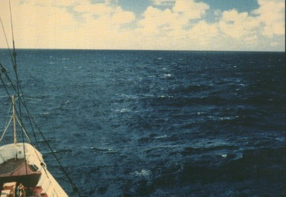
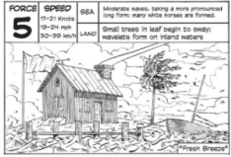
Incoming radar
Scattered radar
Reflected radar
Some of the energy is scattered back to the source
And it then measured as signal:
ASCAT measures backscatter

Slide 19
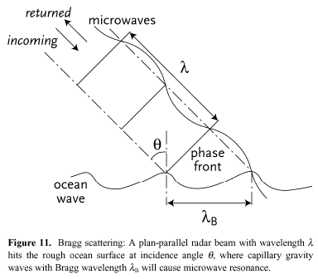
What happens when the radiation hits water?
Bragg scattering:
Incoming microwave radiation in resonance with short waves (dominant for 30°< θ < 70 °)
λ_{B} = λ/(2sin(θ)
Specular reflection:
Ocean facets normal to incident radiation (non-negligible for θ < 30°)
More energy is backscattered where the surface wavelength is similar to the radar wavelength
λ ~ 2cm (Ku-band) ; λ ~ 5cm (C-band)

Slide 20
Ripples / ‘gravity capillary waves’ / surface roughness
It is the ripples (not the big waves) that matter

Slide 21
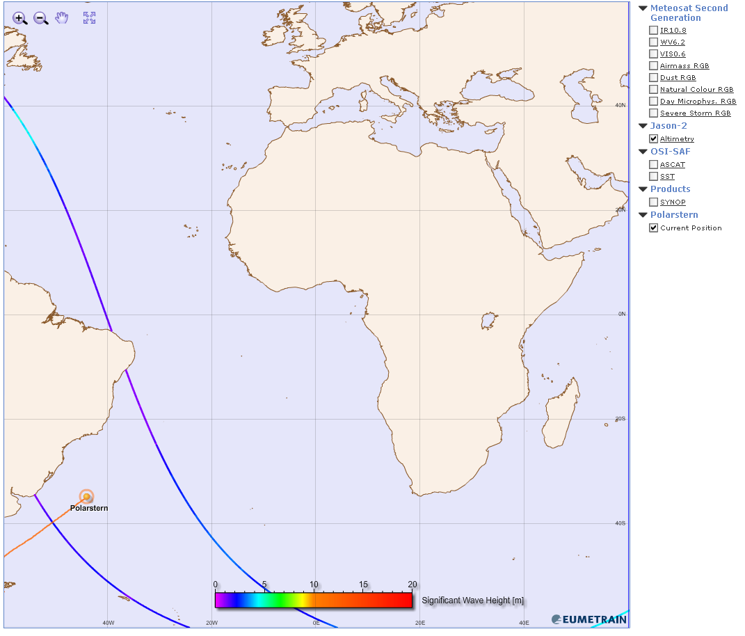
April 17
09UTC

Slide 22
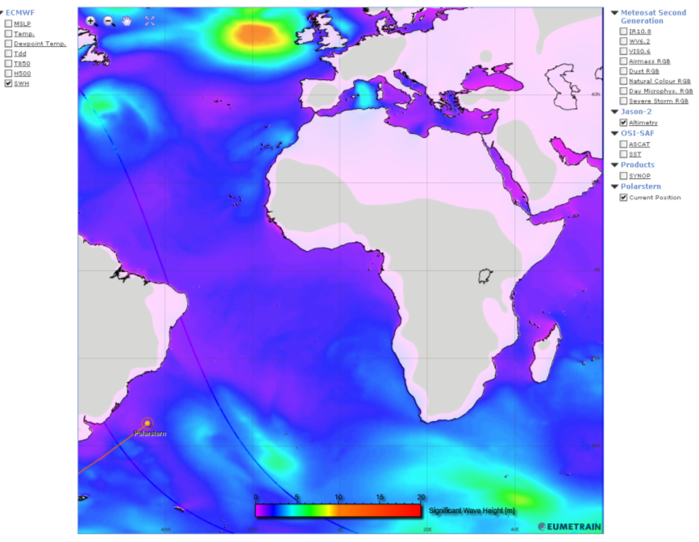
April 17
09UTC

Slide 23
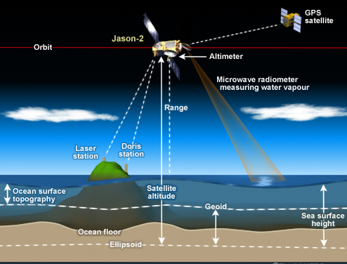
From COMET module on altimetry and Jason satellites

